Slide 1
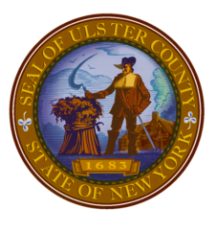
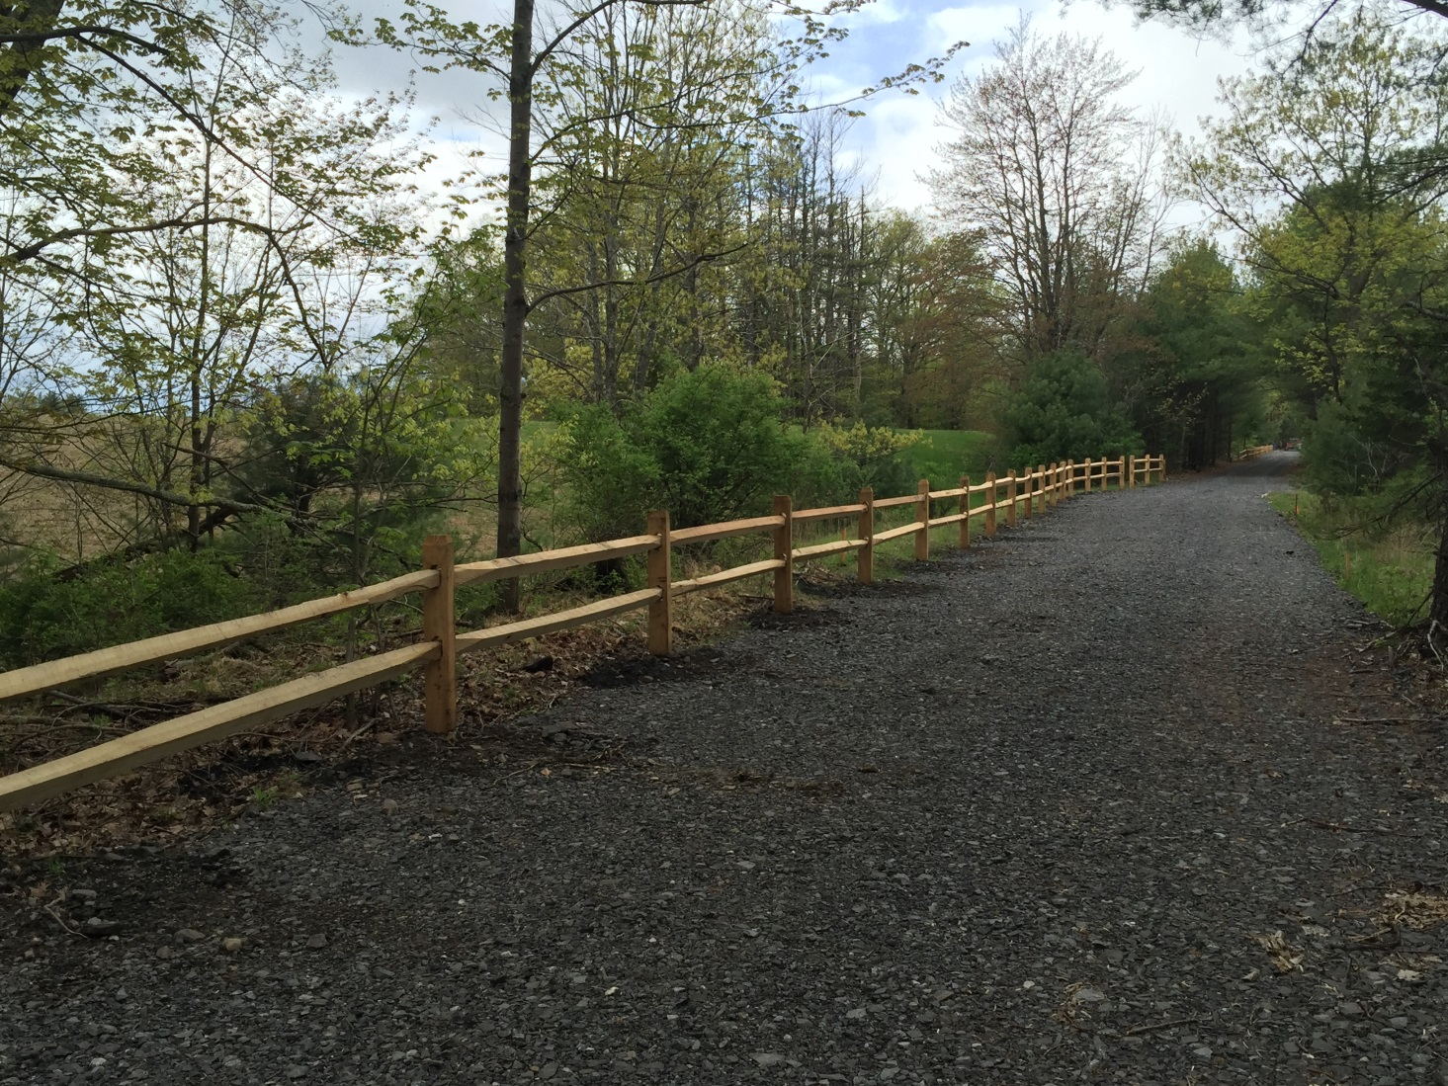
Ashokan Rail Trail
Phase 2: Trail And Butternut Bridge Construction

Slide 2
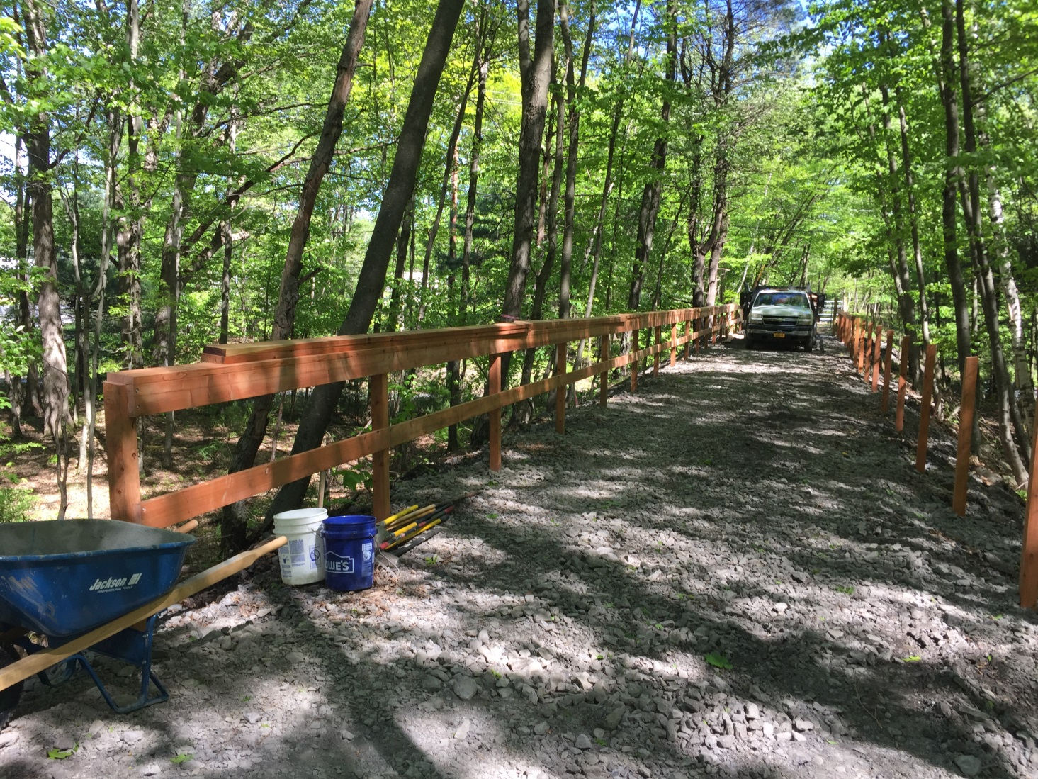
Ashokan Rail Trail
Phase 2: Trail And Butternut Bridge Construction

Slide 3
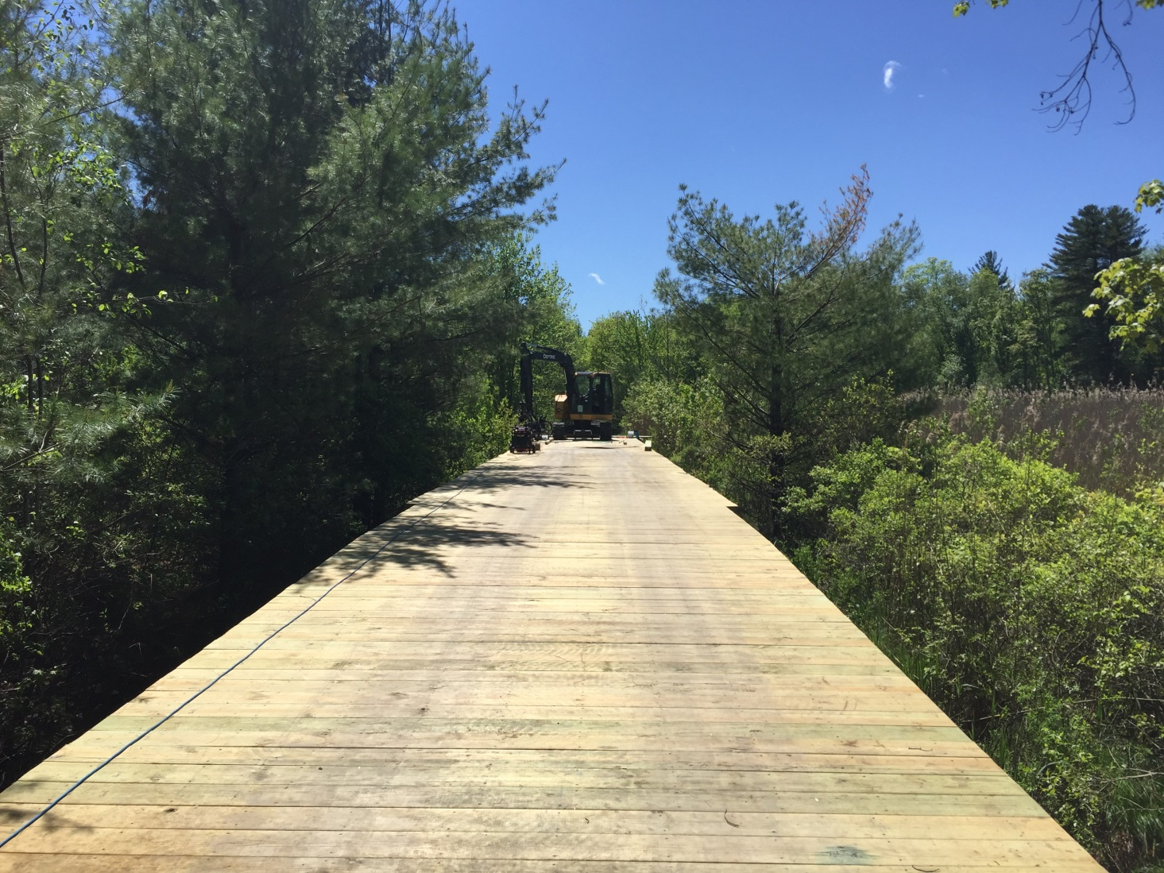
Ashokan Rail Trail
Phase 2: Trail And Butternut Bridge Construction

Slide 4
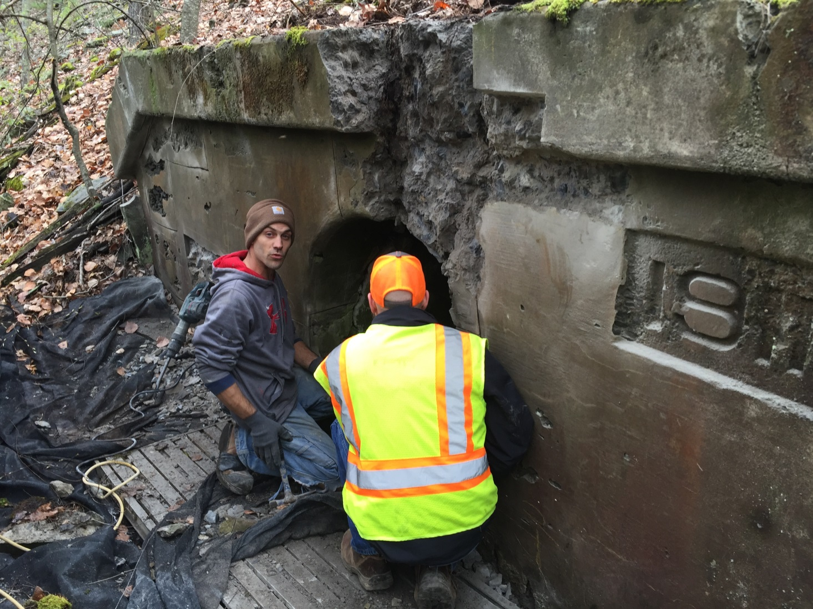
Ashokan Rail Trail
Phase 2: Trail And Butternut Bridge Construction

Slide 5
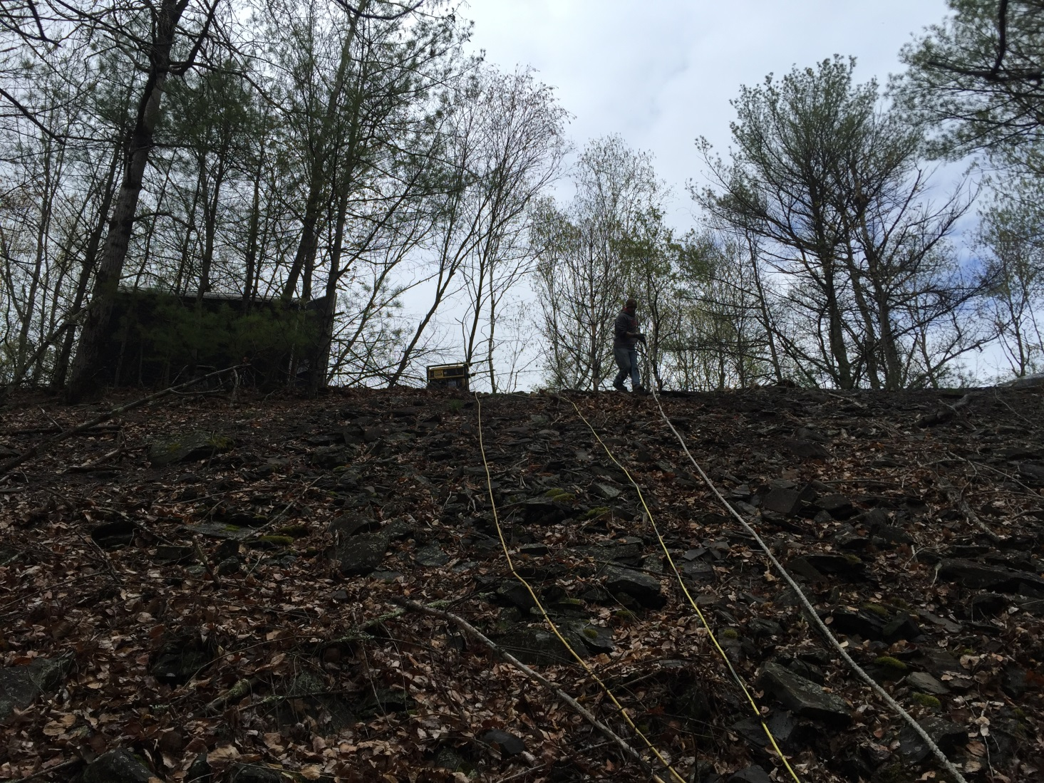
Ashokan Rail Trail
Phase 2: Trail And Butternut Bridge Construction

Slide 6
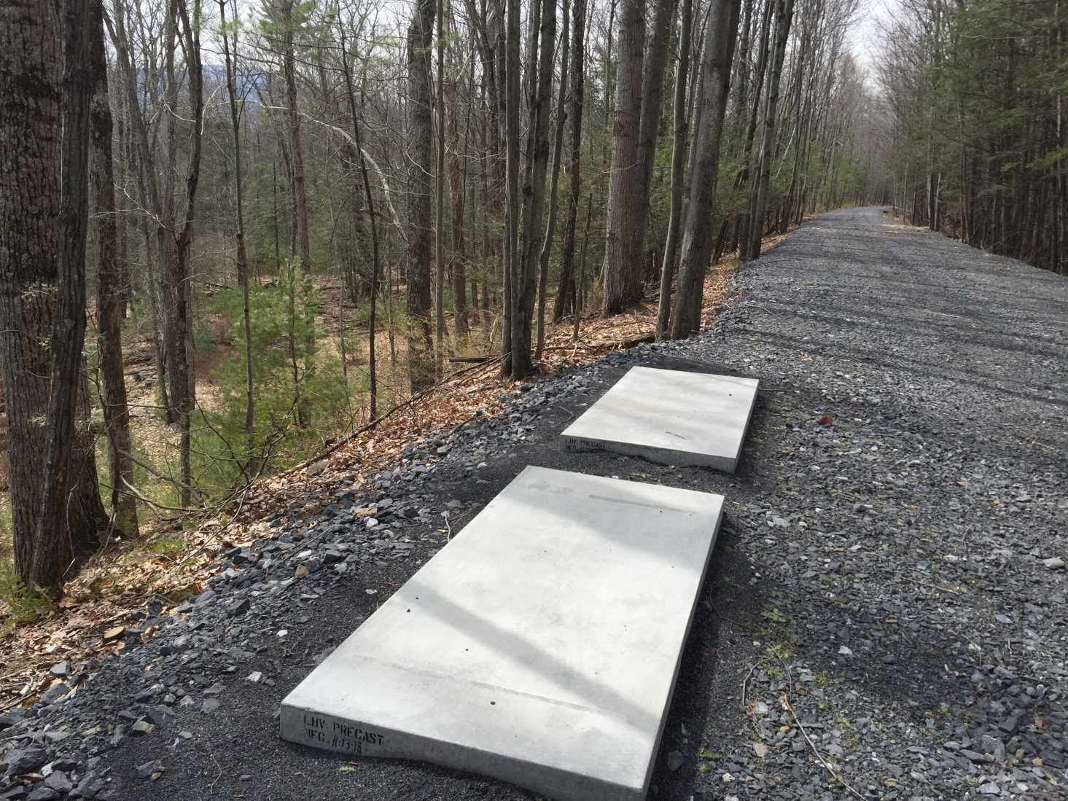
Ashokan Rail Trail
Phase 2: Trail And Butternut Bridge Construction

Slide 7
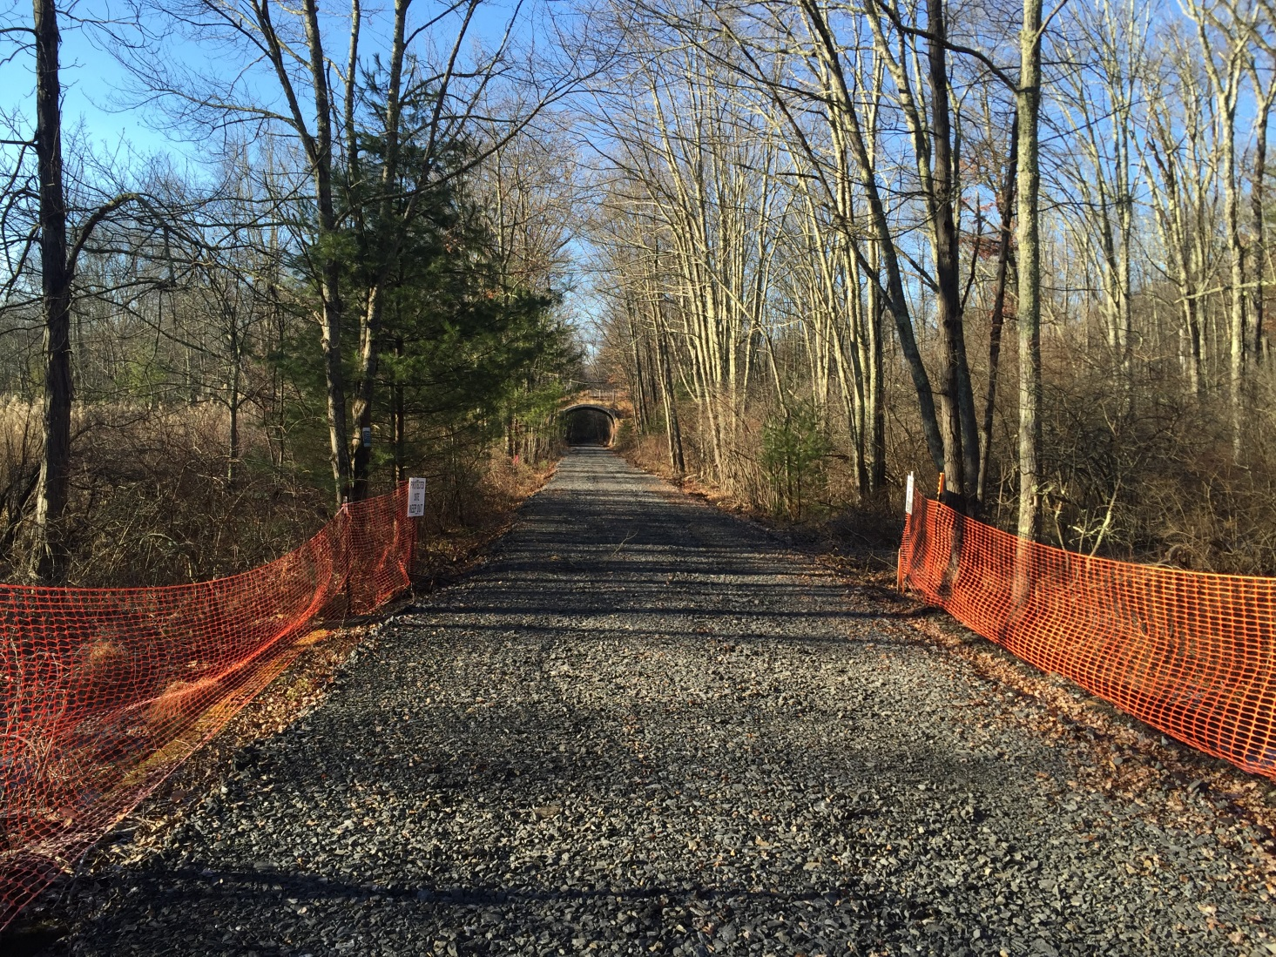
Ashokan Rail Trail
Phase 2: Trail And Butternut Bridge Construction

Slide 8
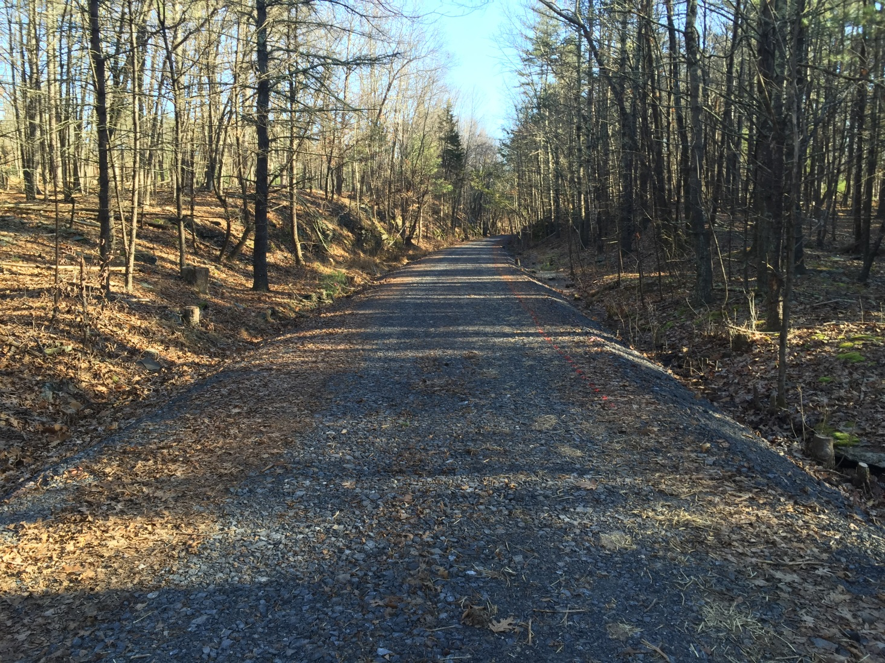
Ashokan Rail Trail
Phase 2: Trail And Butternut Bridge Construction

Slide 9
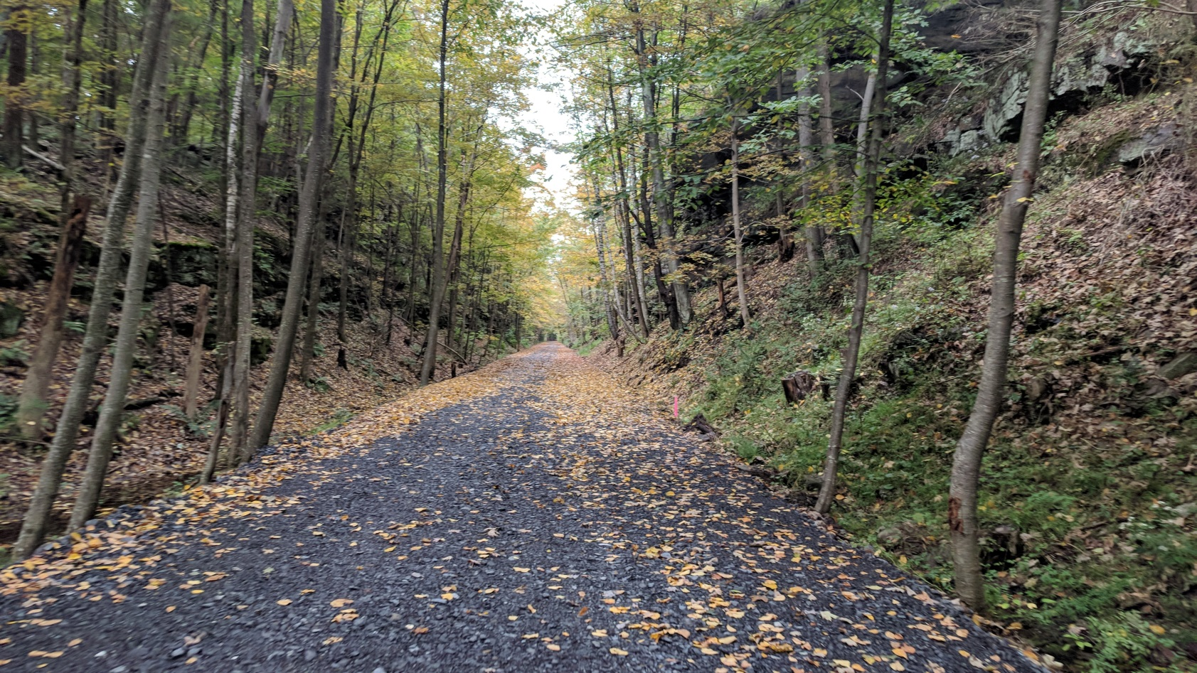
Ashokan Rail Trail
Phase 2: Trail And Butternut Bridge Construction

Slide 10
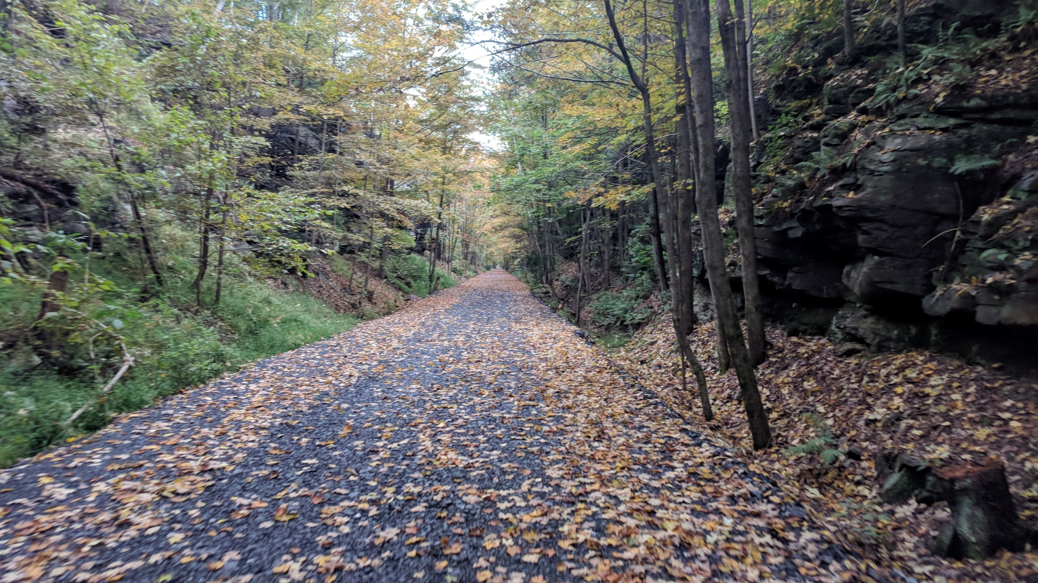
Ashokan Rail Trail
Phase 2: Trail And Butternut Bridge Construction

Slide 11
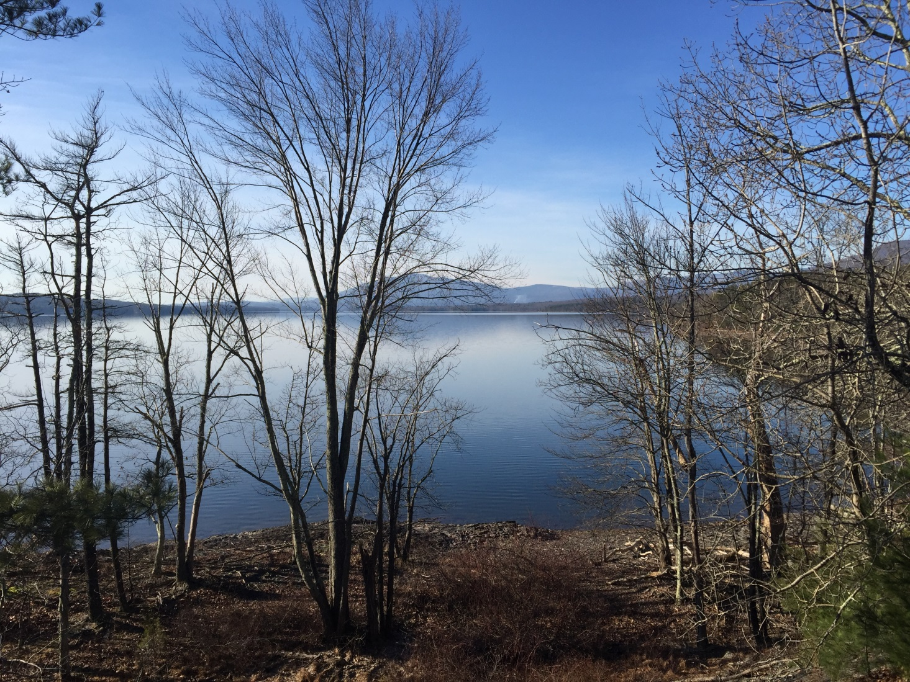
Ashokan Rail Trail
Phase 2: Trail And Butternut Bridge Construction

Slide 12
Ashokan Rail Trail
Phase 3: Boiceville Bridge Project
Construction of new 360-ft. bridge over the Esopus Creek in Boiceville
Includes removal of destroyed former Boiceville Trestle from Esopus Creek
Construction began April 1, 2019
Anticipated completion in November 2019
Public Opening in December 2019/ Jan. 2020

Slide 13
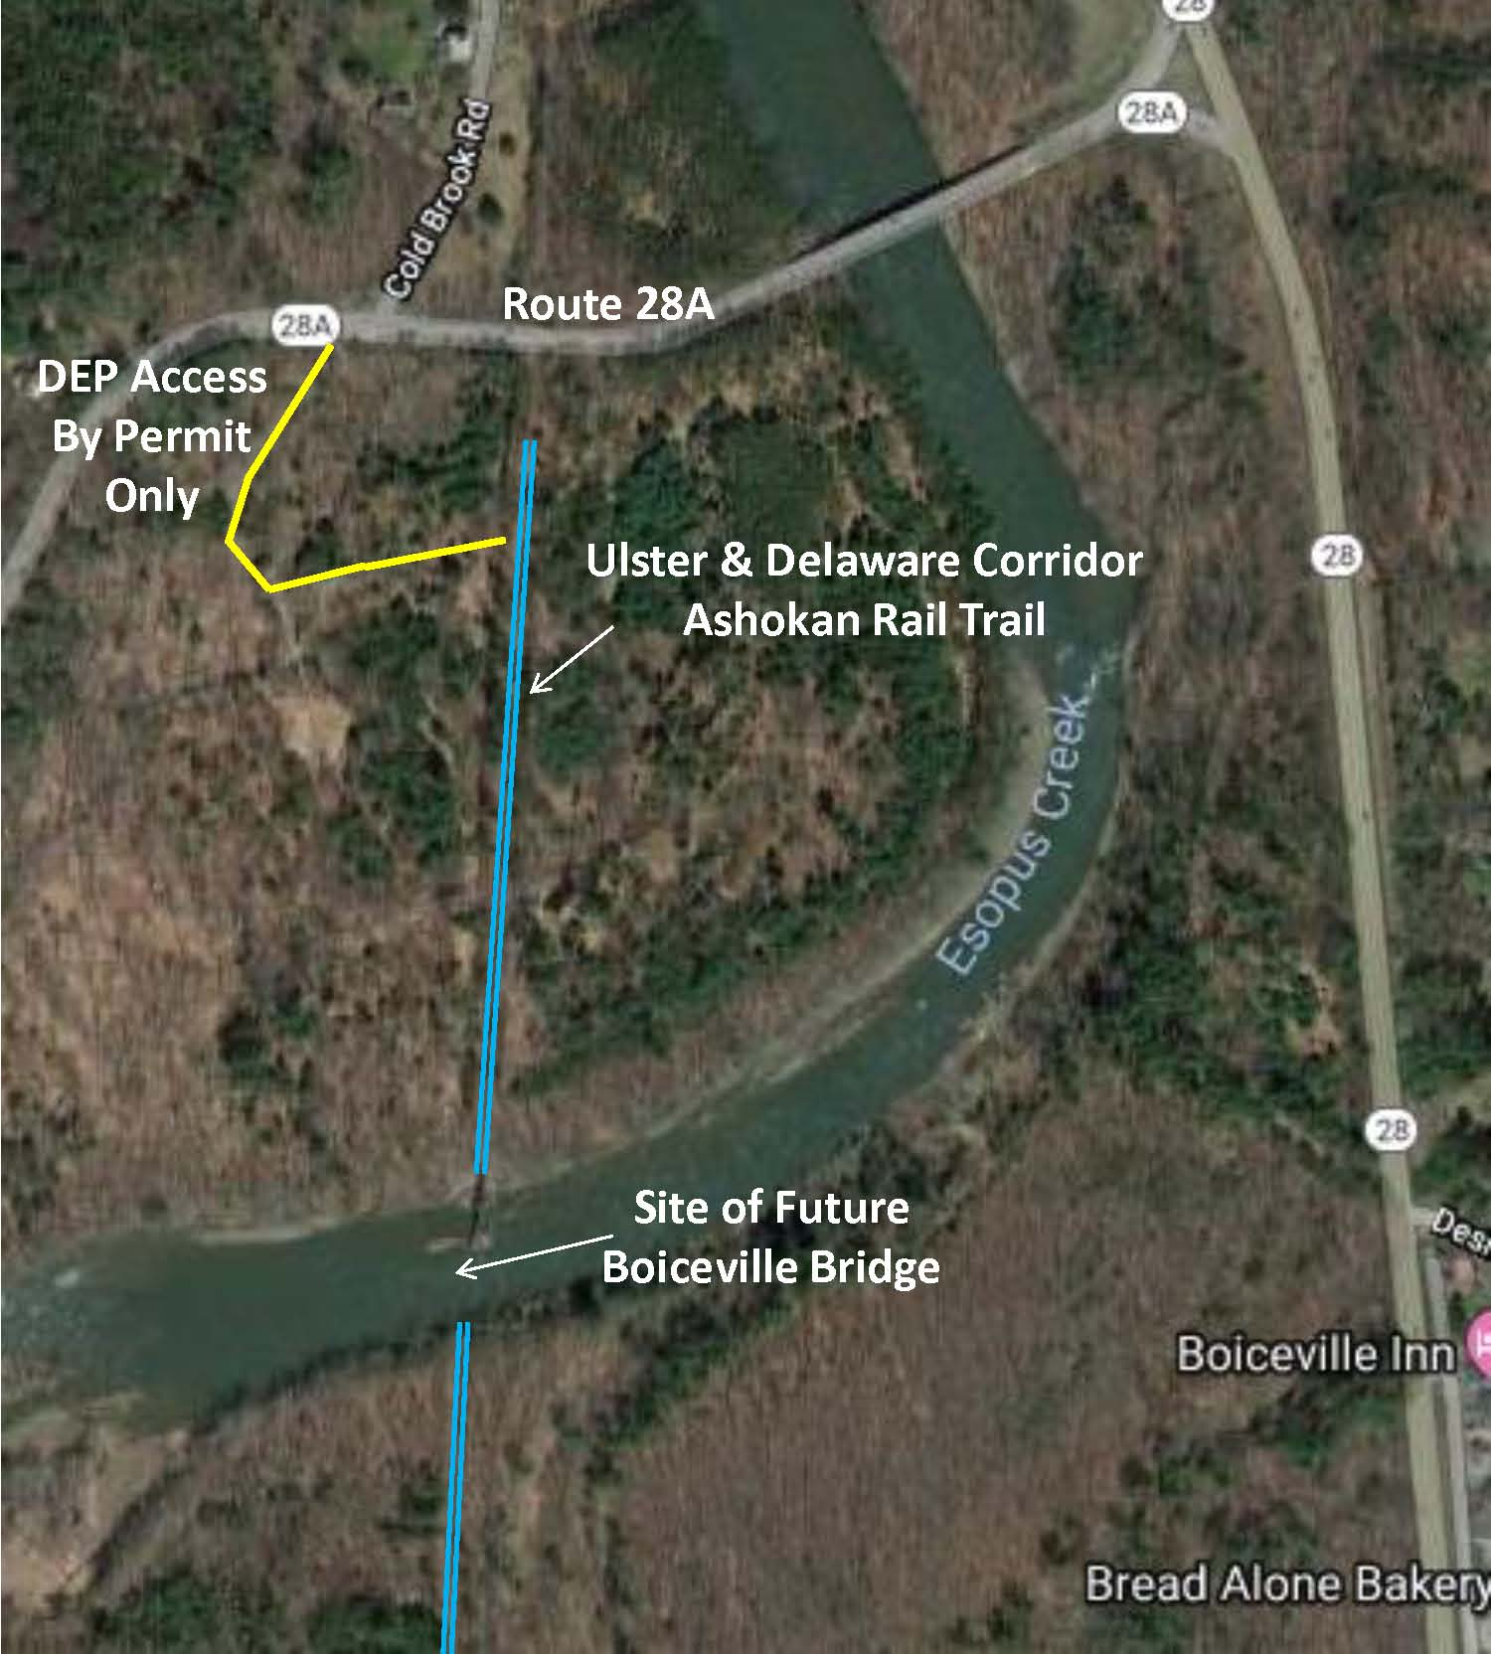
Ashokan Rail Trail
Phase 3: Boiceville Bridge Project

Slide 14
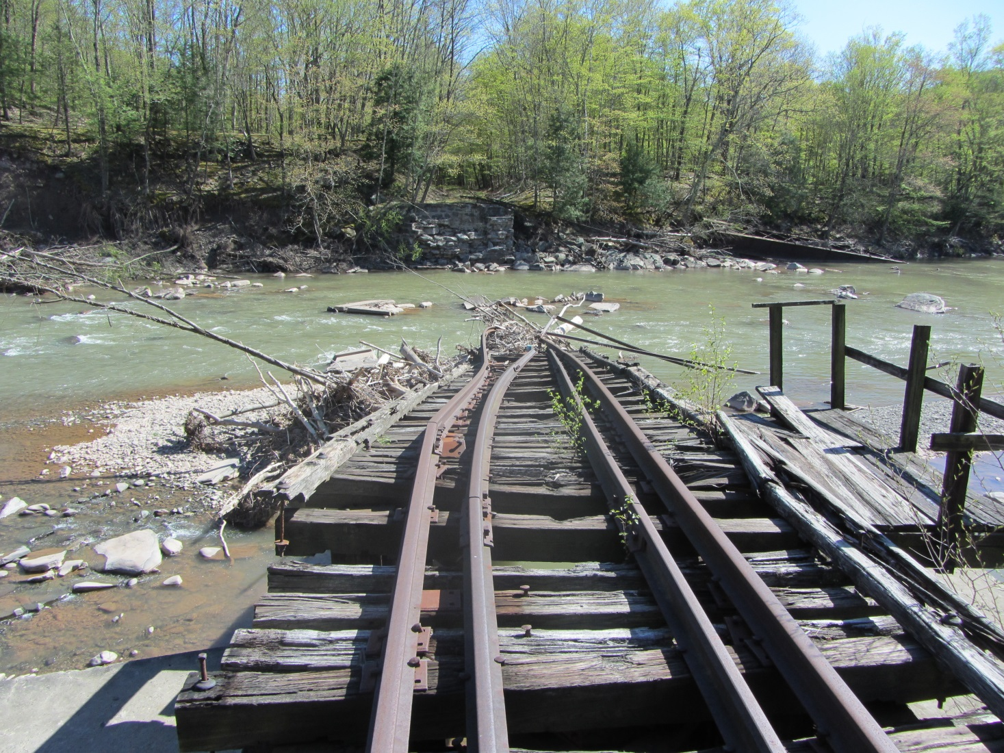
Ashokan Rail Trail
Phase 3: Boiceville Bridge Project

Slide 15
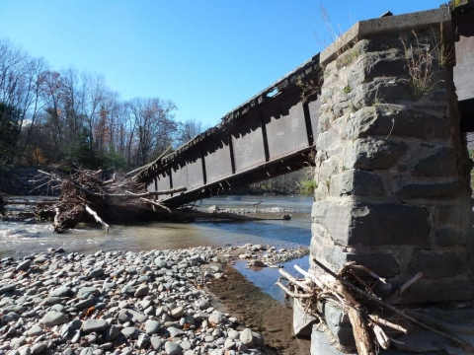
Ashokan Rail Trail
Phase 3: Boiceville Bridge Project

Slide 16
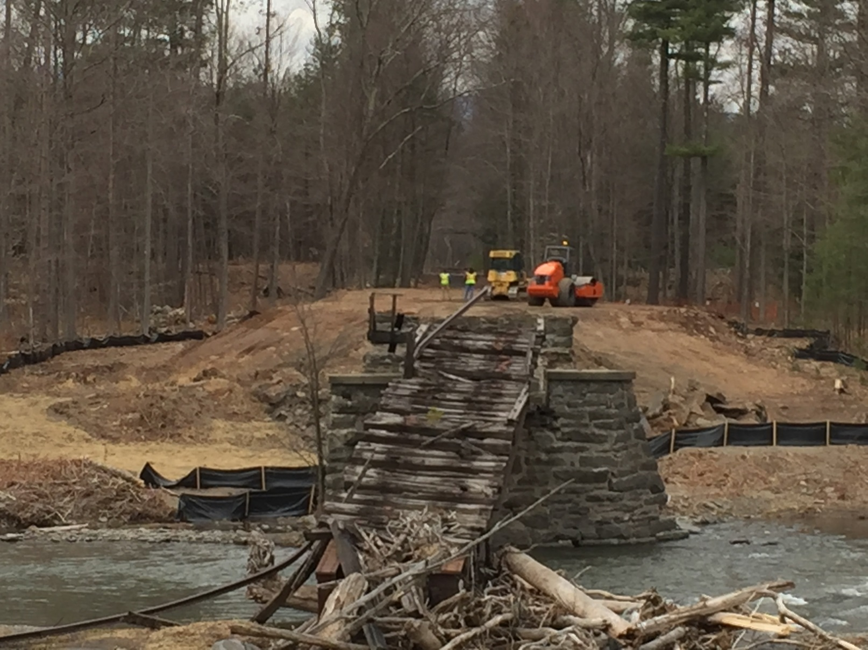
Ashokan Rail Trail
Phase 3: Boiceville Bridge Project

Slide 17
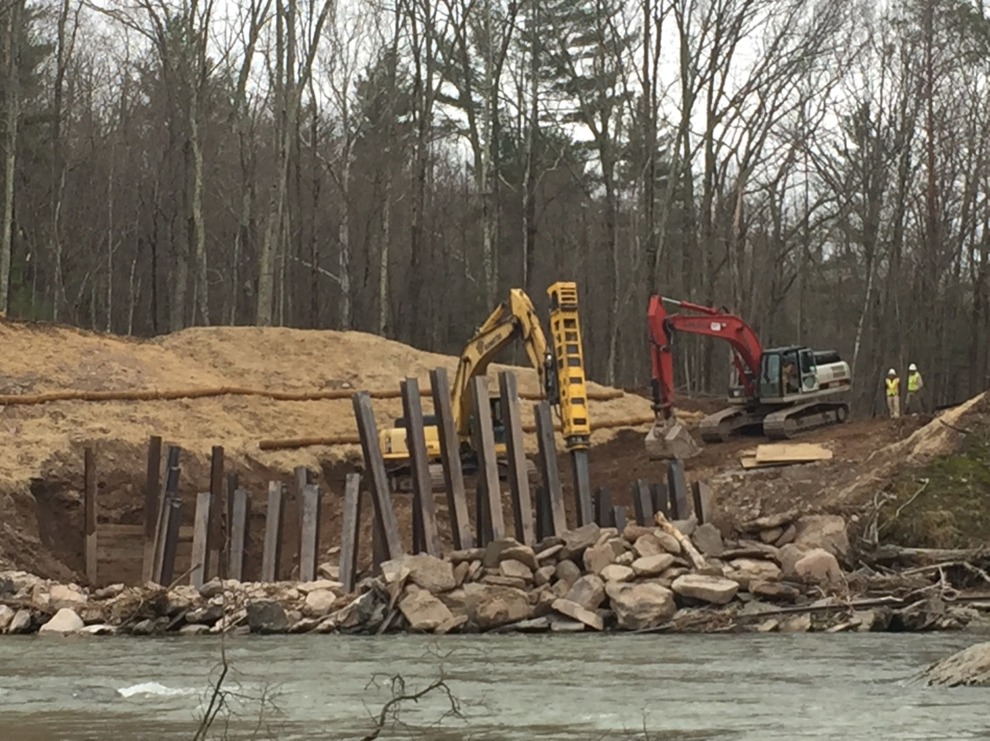
Ashokan Rail Trail
Phase 3: Boiceville Bridge Project

Slide 18
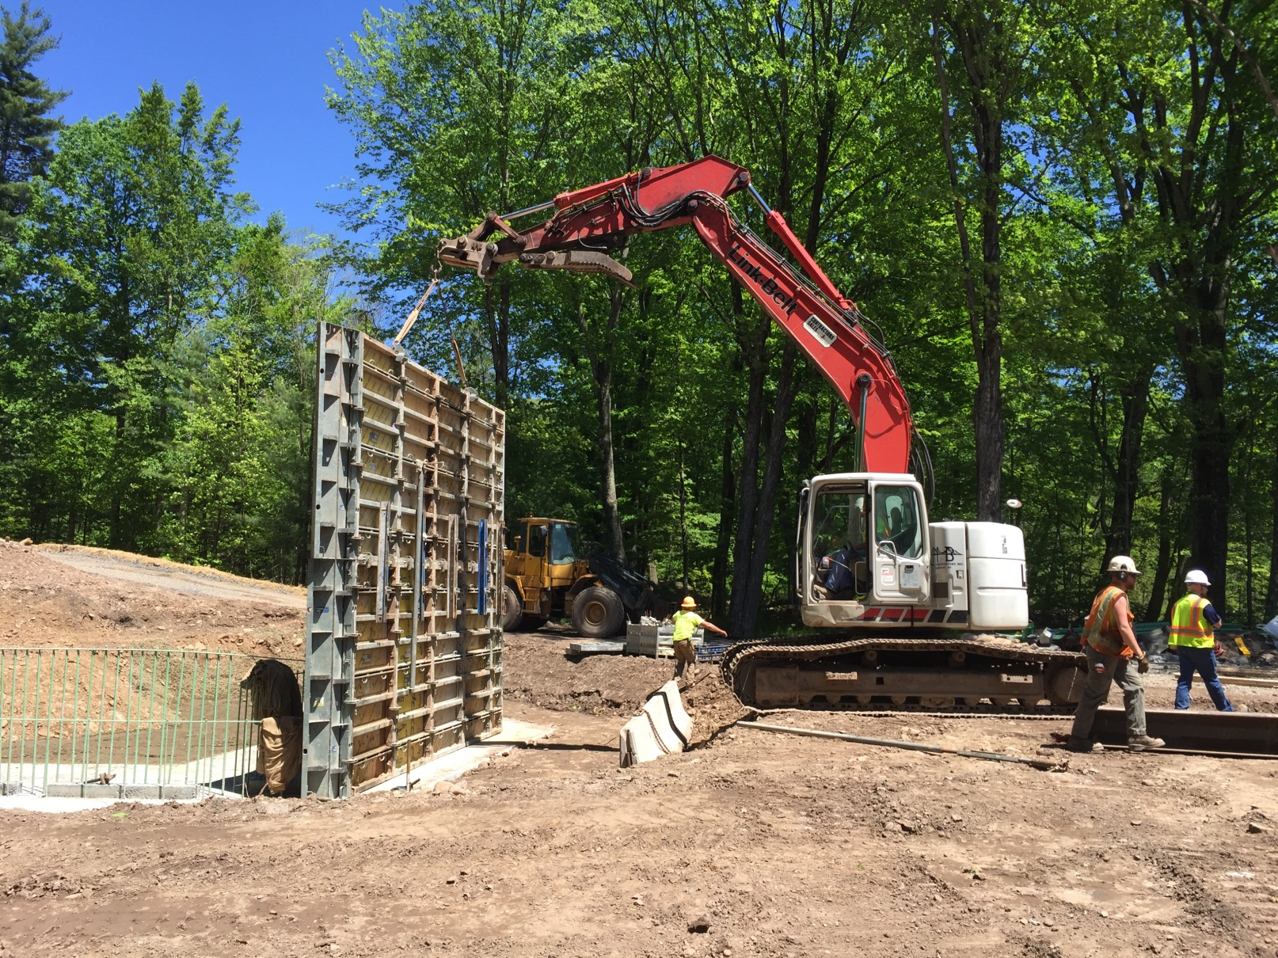
Ashokan Rail Trail
Phase 3: Boiceville Bridge Project

Slide 19
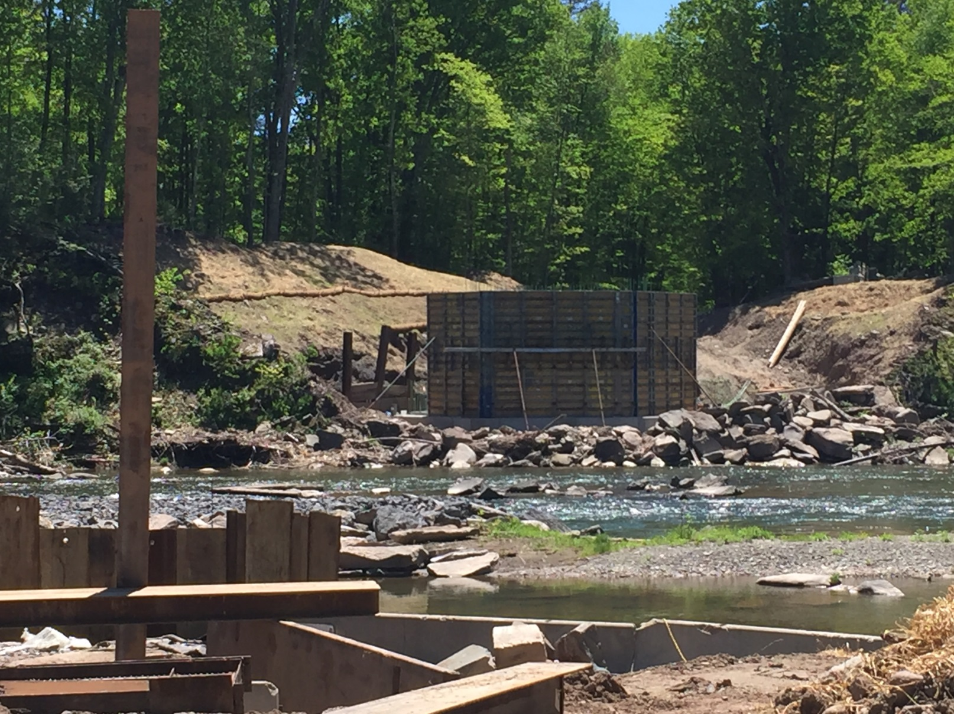
Ashokan Rail Trail
Phase 3: Boiceville Bridge Project

Slide 20
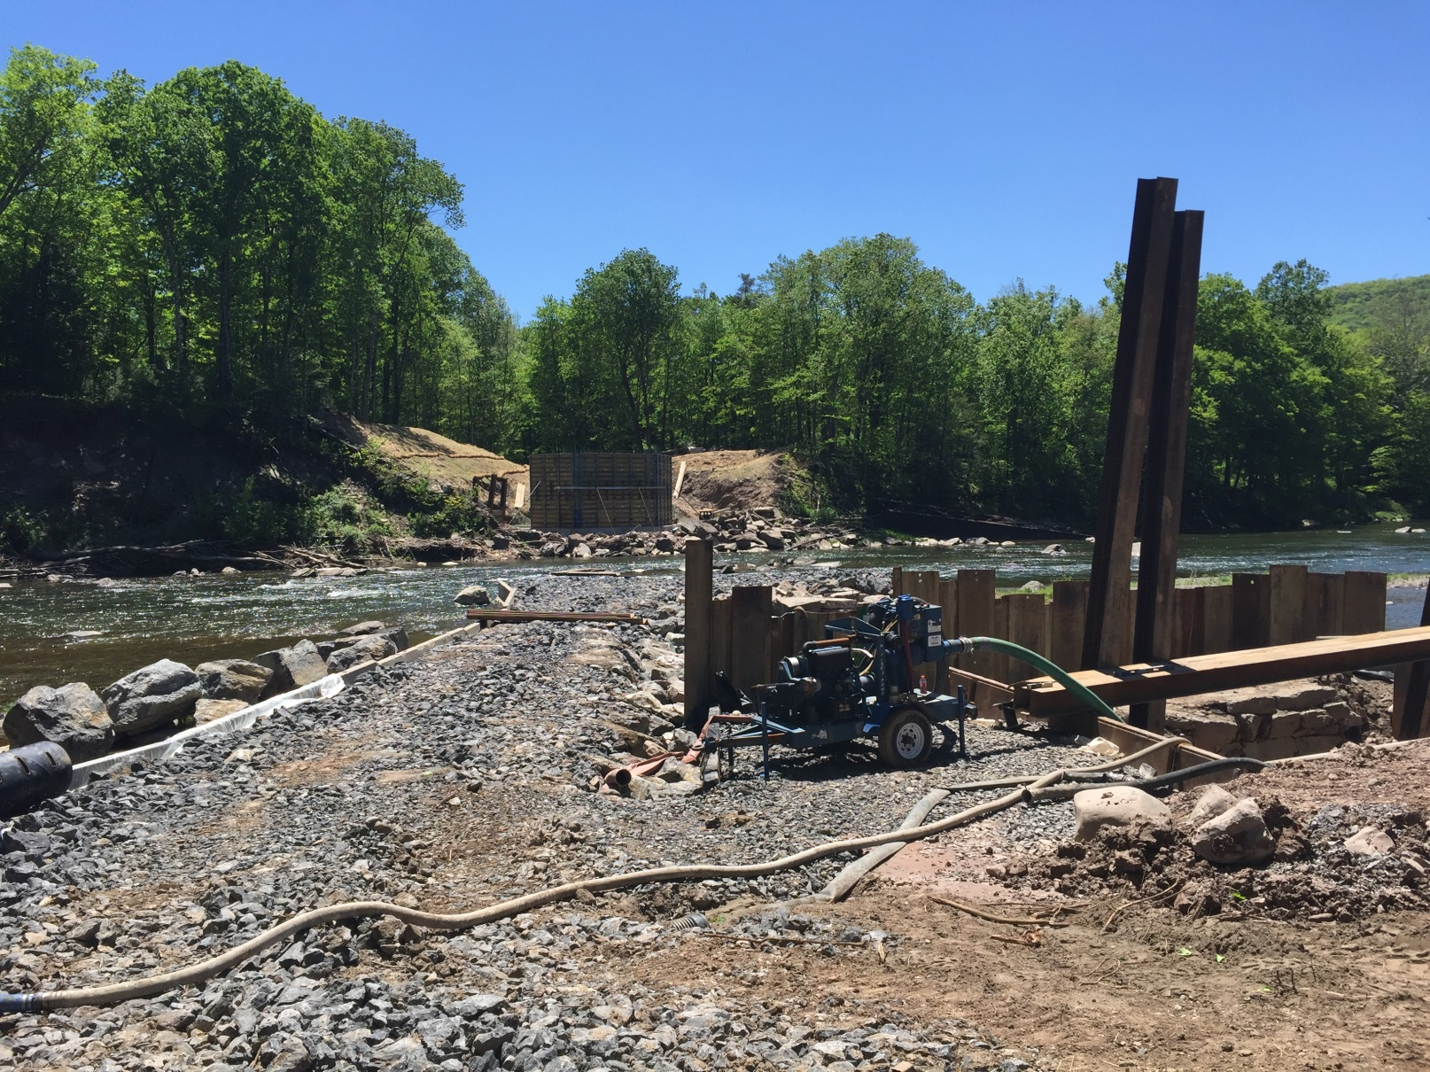
Ashokan Rail Trail
Phase 3: Boiceville Bridge Project

Slide 21
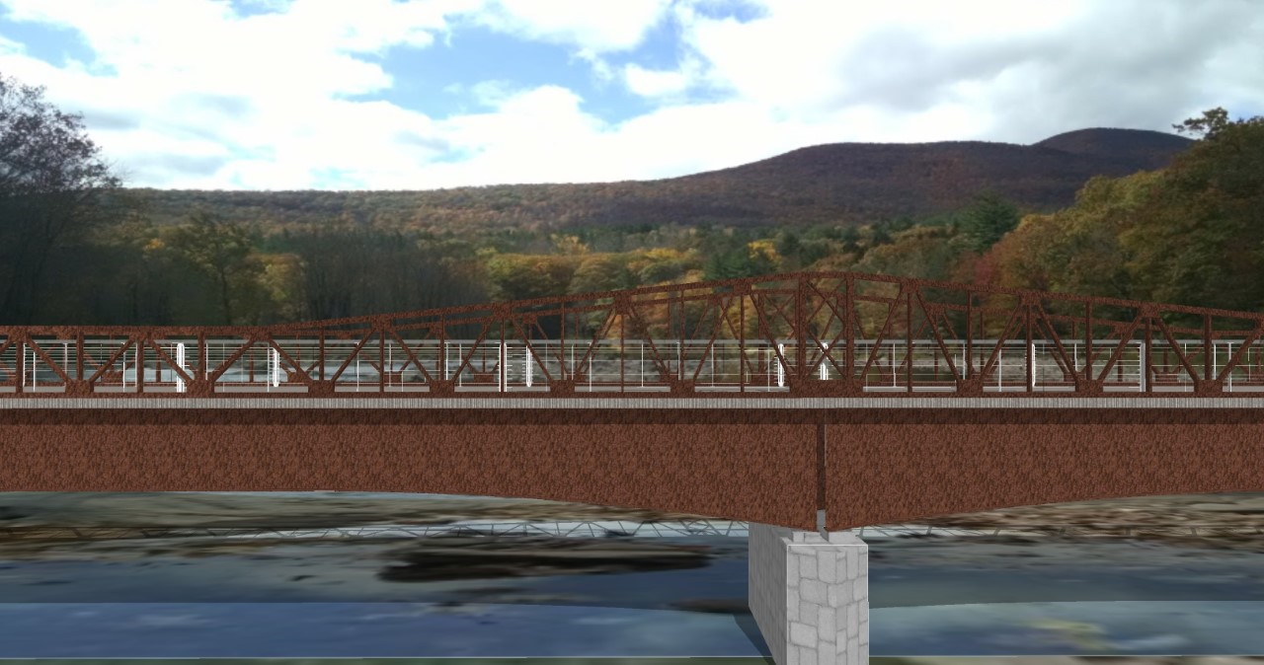
Ashokan Rail Trail
Phase 3: Boiceville Bridge Project

Slide 22
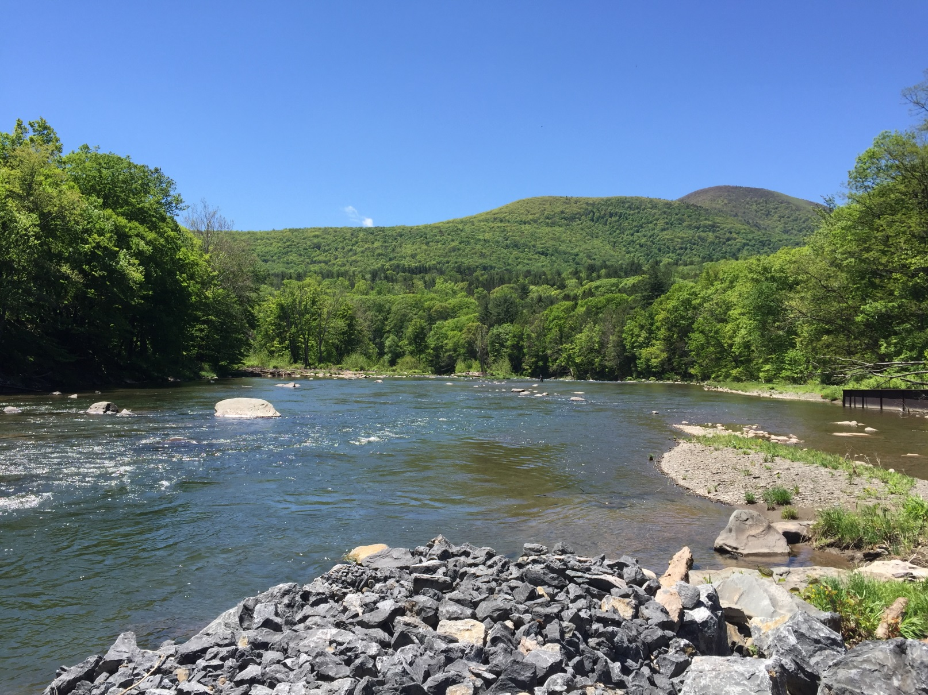
Ashokan Rail Trail
Phase 3: Boiceville Bridge Project

Slide 23
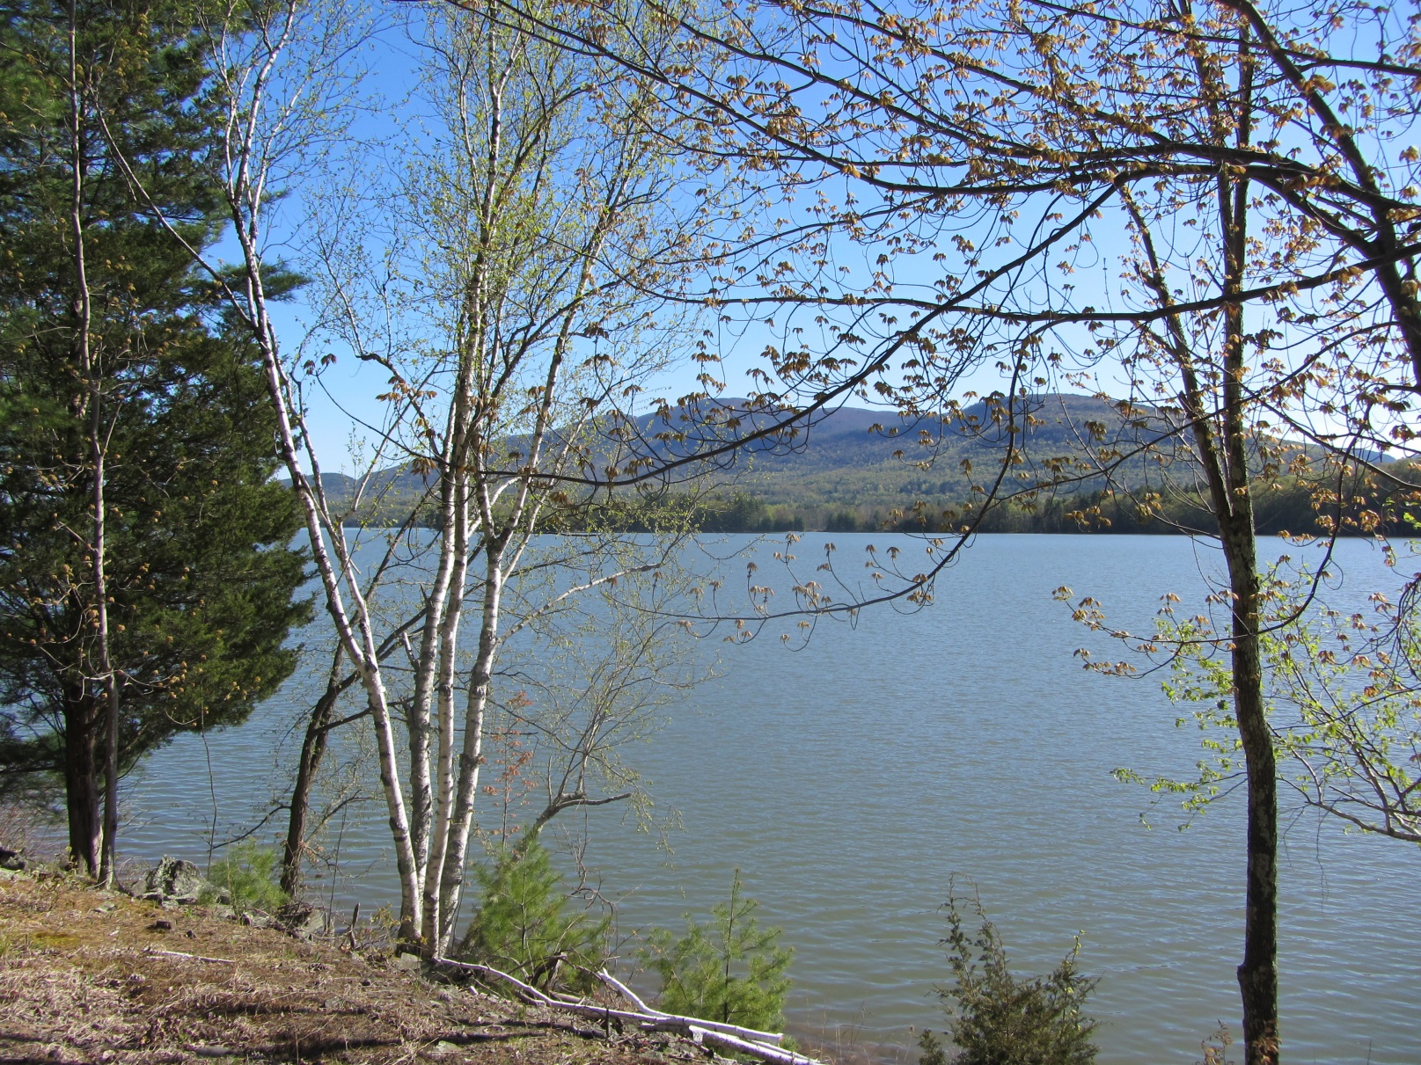
Ashokan Rail Trail
Phase 3: Boiceville Bridge Project

Slide 24
Ashokan Rail Trail
Phase 4: Ashokan Station & Woodstock Dike Trailheads
Construction of crushed-stone parking area/ trailhead at Woodstock Dike Fishing Area in West Hurley
Construction of paved parking area/ trailhead at
Ashokan Station in Shokan
Funded and maintained by NYC DEP
Submitted for June 2019 Legislative Approval
Completion in October 2019

Slide 25
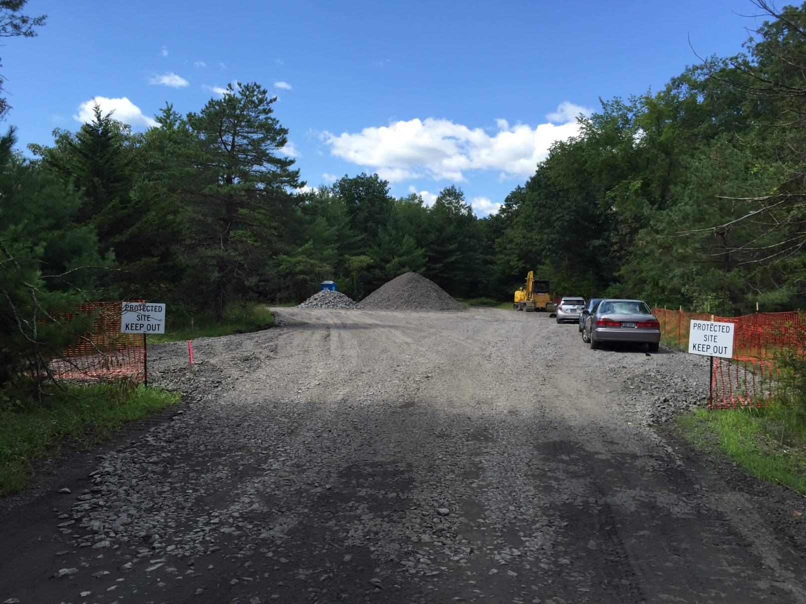
Ashokan Rail Trail
Phase 4: Ashokan Station & Woodstock Dike Trailheads

Slide 26
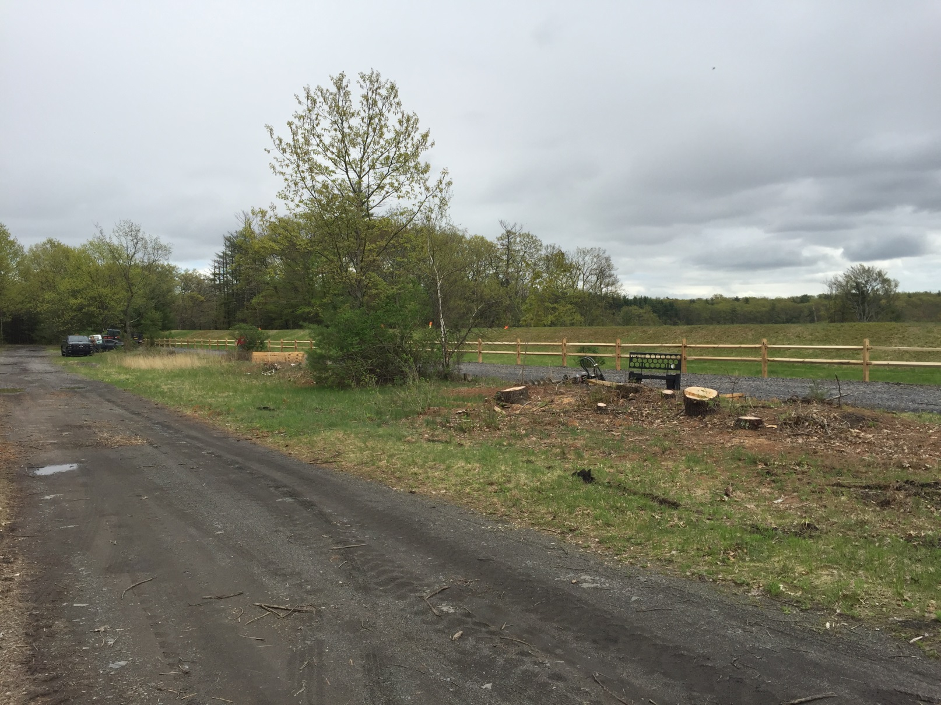
Ashokan Rail Trail
Phase 4: Ashokan Station & Woodstock Dike Trailheads

Slide 27
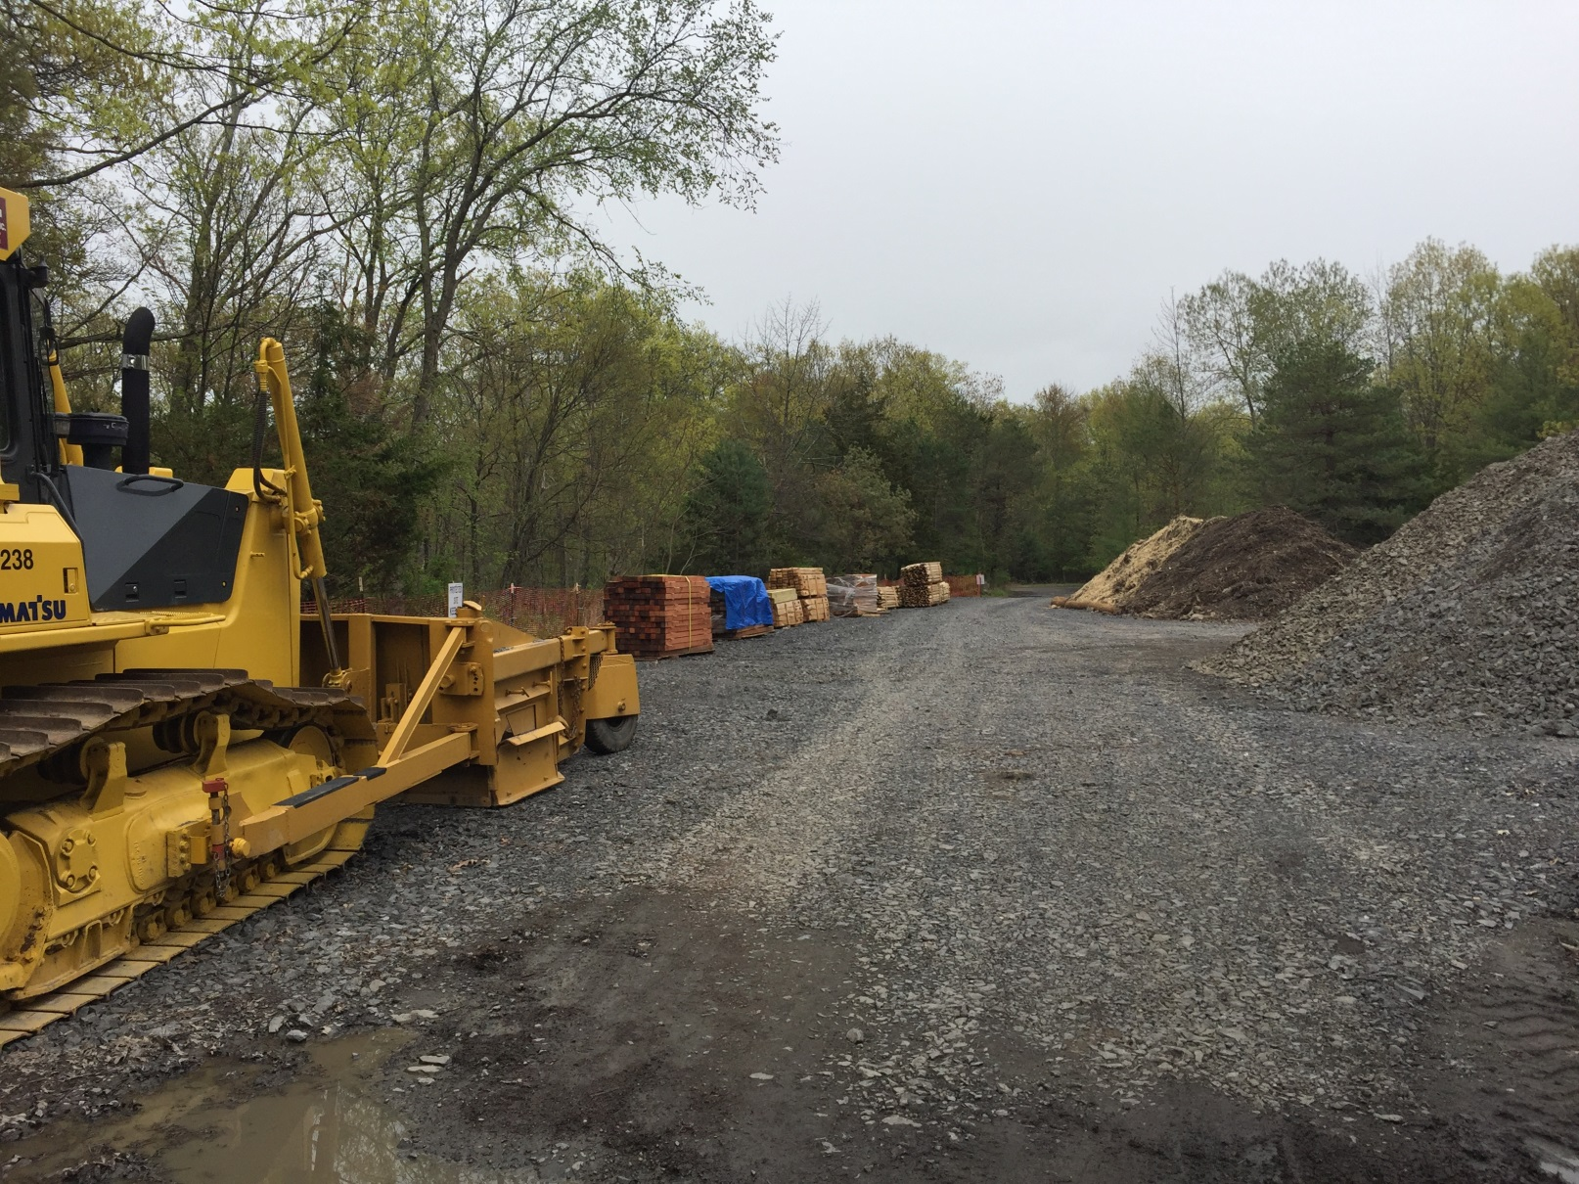
Ashokan Rail Trail
Phase 4: Ashokan Station & Woodstock Dike Trailheads

Slide 28
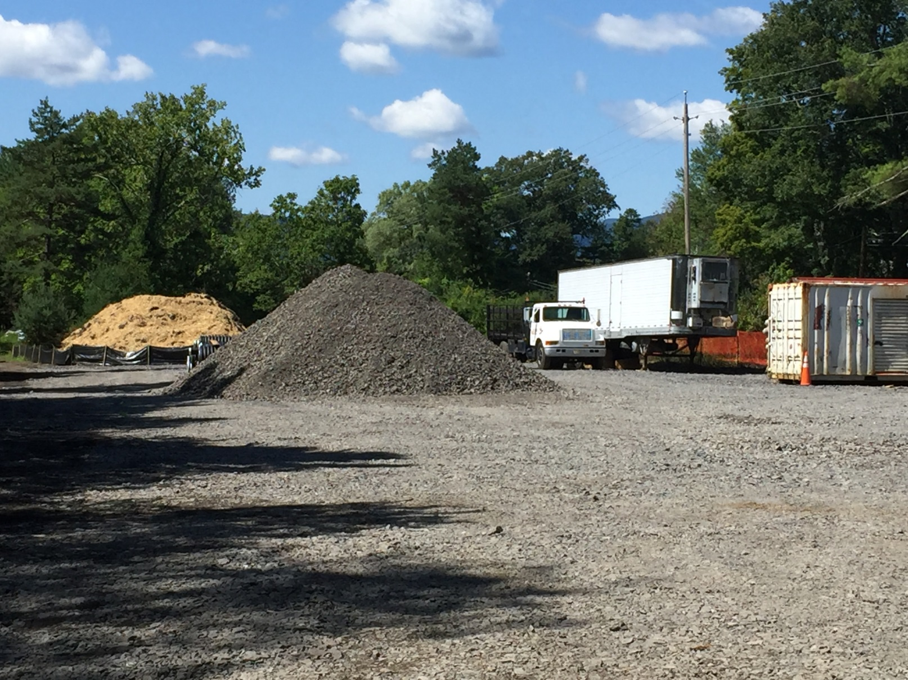
Ashokan Rail Trail
Phase 4: Ashokan Station & Woodstock Dike Trailheads

Slide 29
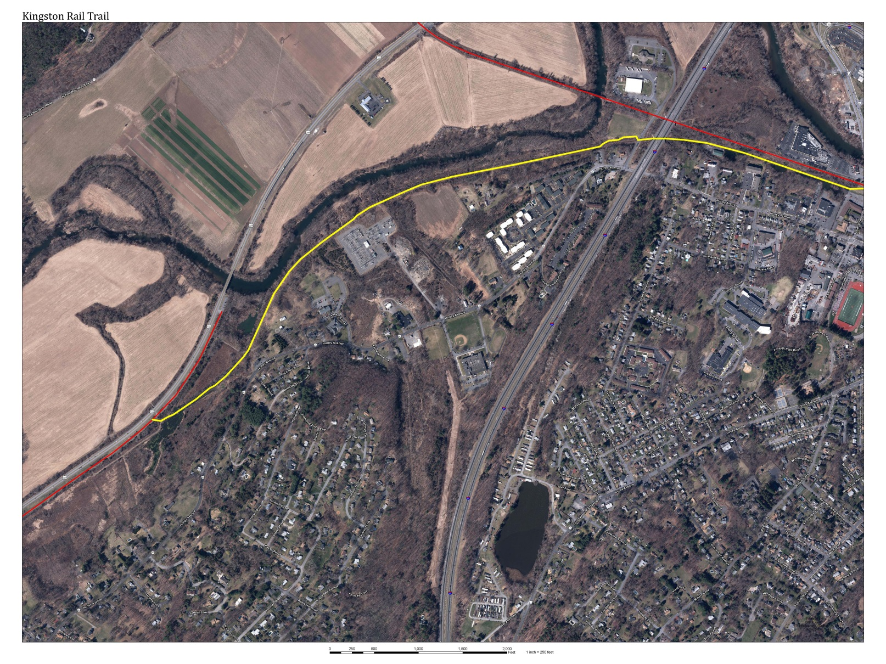
Kingston Rail Trail
O&W-Hurley Rail Trail to City of Kingston
Route 209
Washington
Avenue
NYS Thruway
Hurley Rail Trail

Slide 30
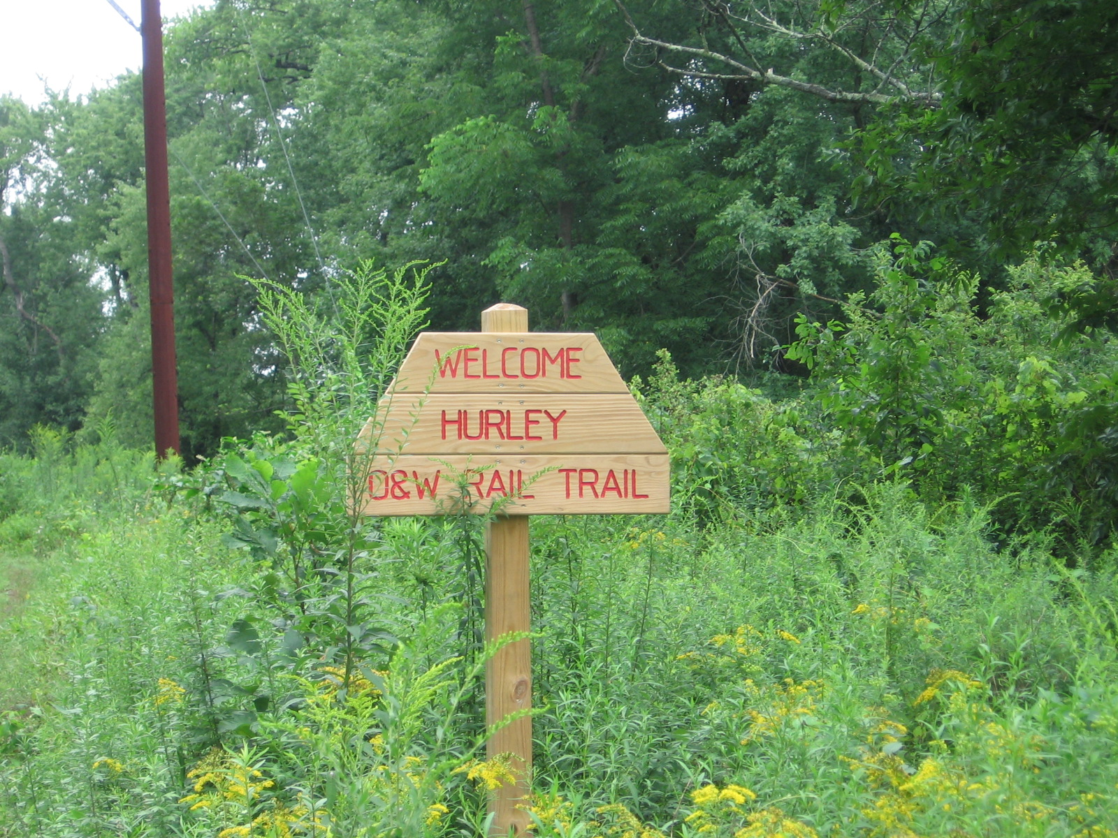
Kingston Rail Trail
O&W-Hurley Rail Trail to City of Kingston

Slide 31
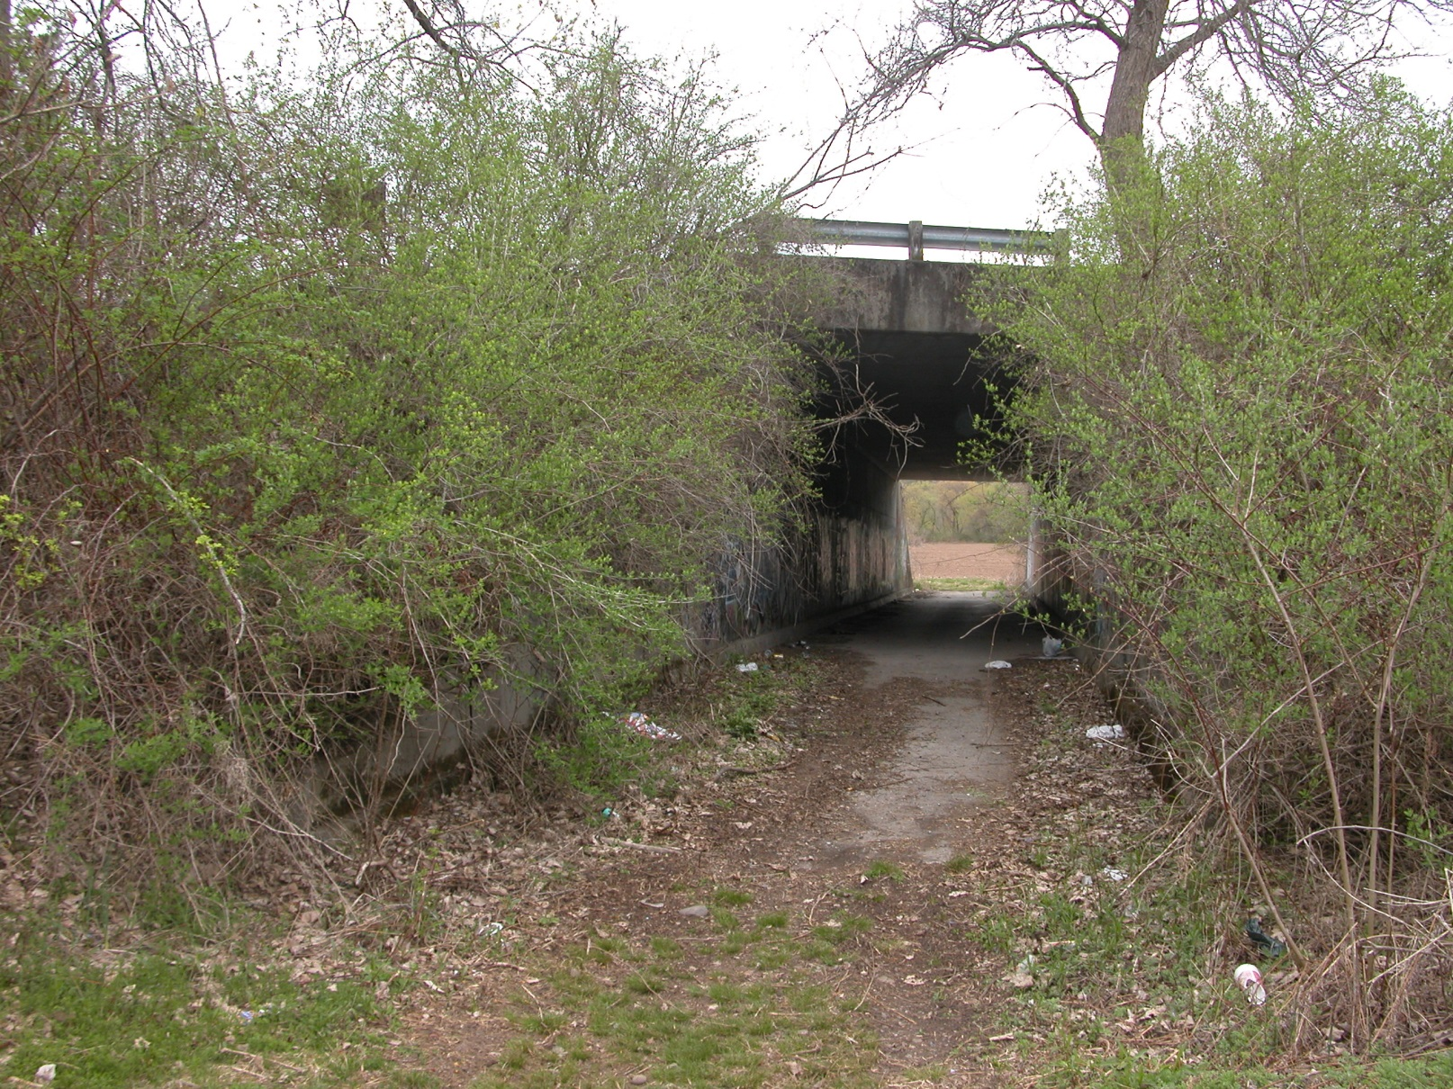
Kingston Rail Trail
O&W-Hurley Rail Trail to City of Kingston

Slide 32
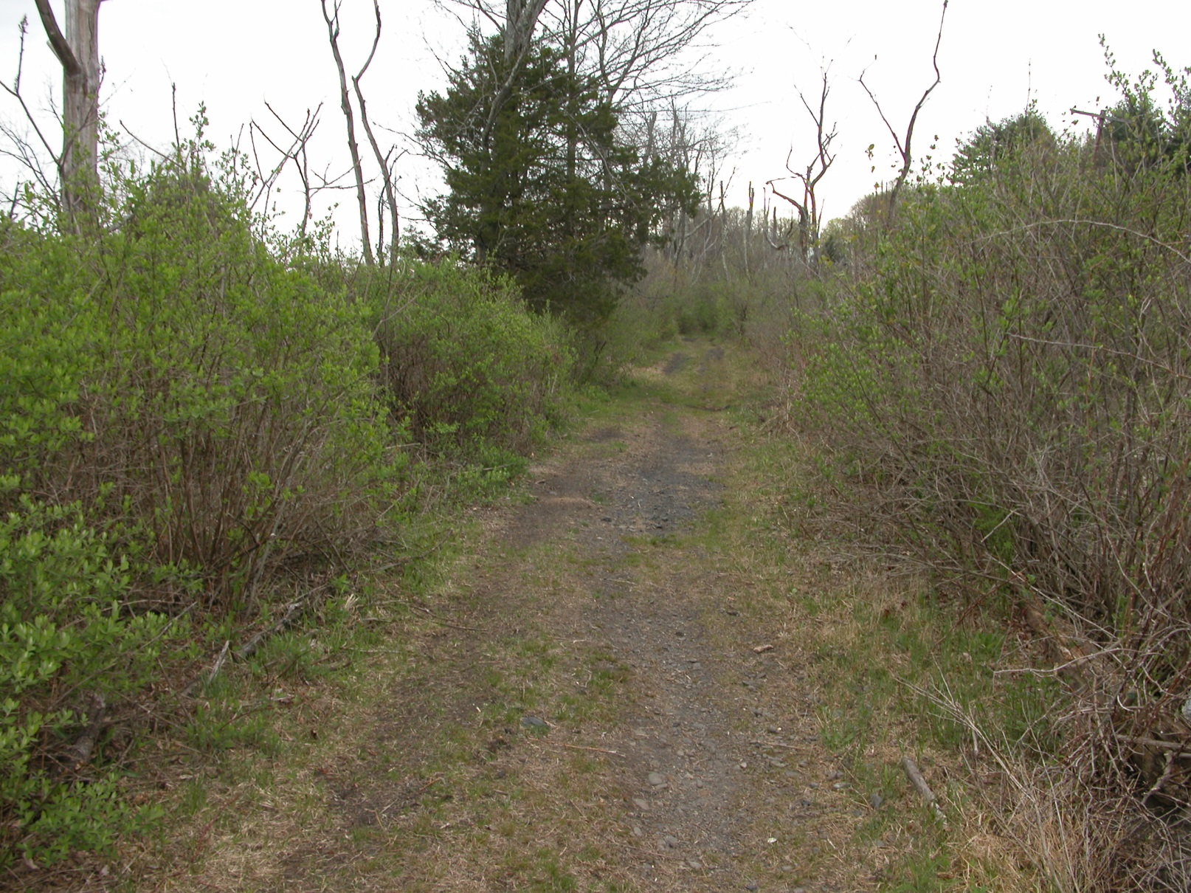
Kingston Rail Trail
O&W-Hurley Rail Trail to City of Kingston

Slide 33
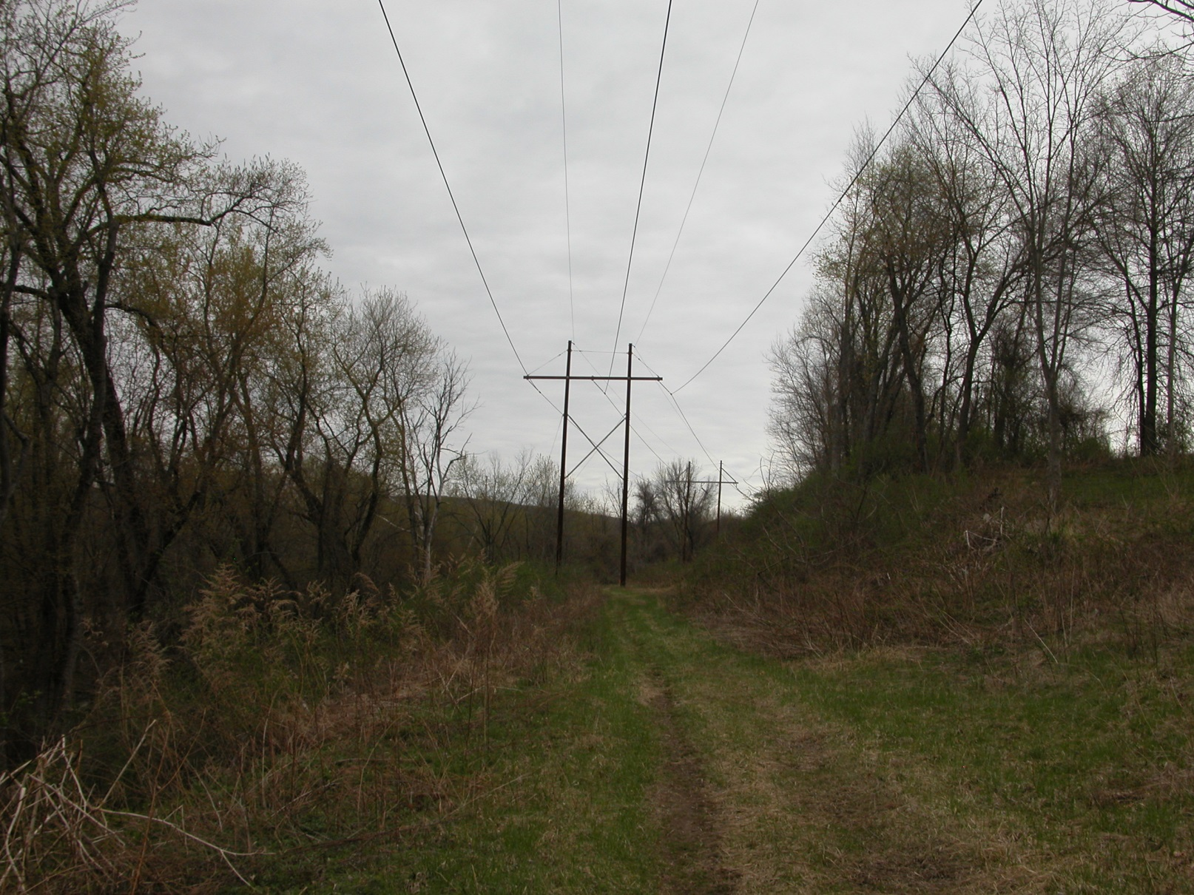
Kingston Rail Trail
O&W-Hurley Rail Trail to City of Kingston

Slide 34
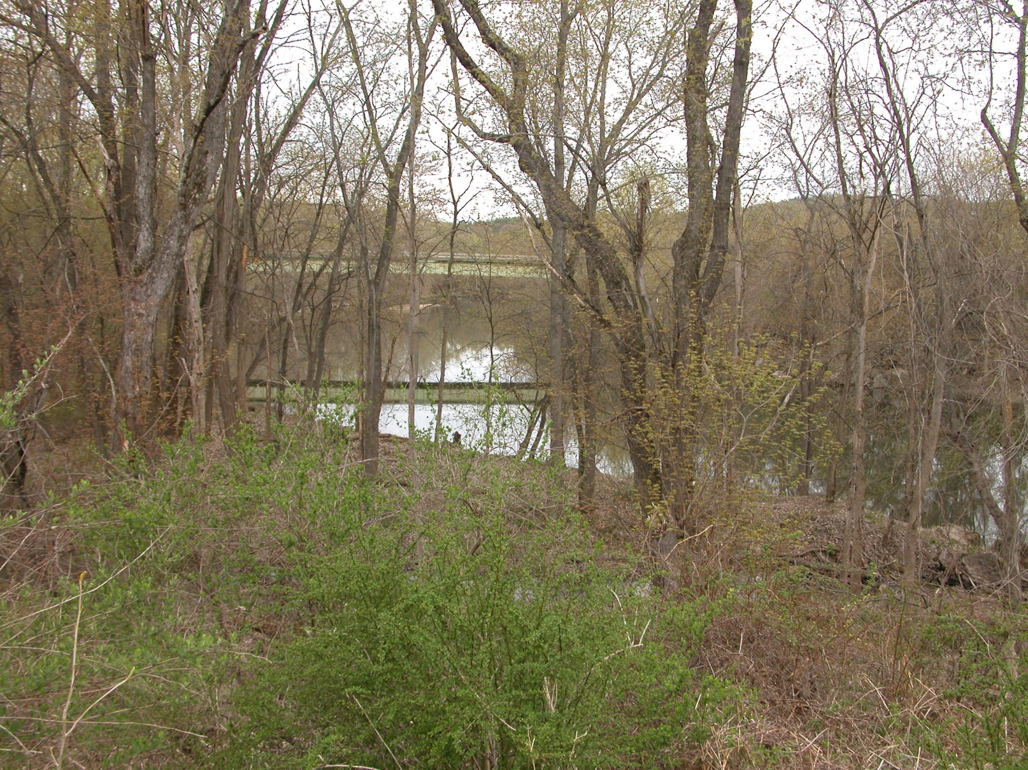
Kingston Rail Trail
O&W-Hurley Rail Trail to City of Kingston

Slide 35
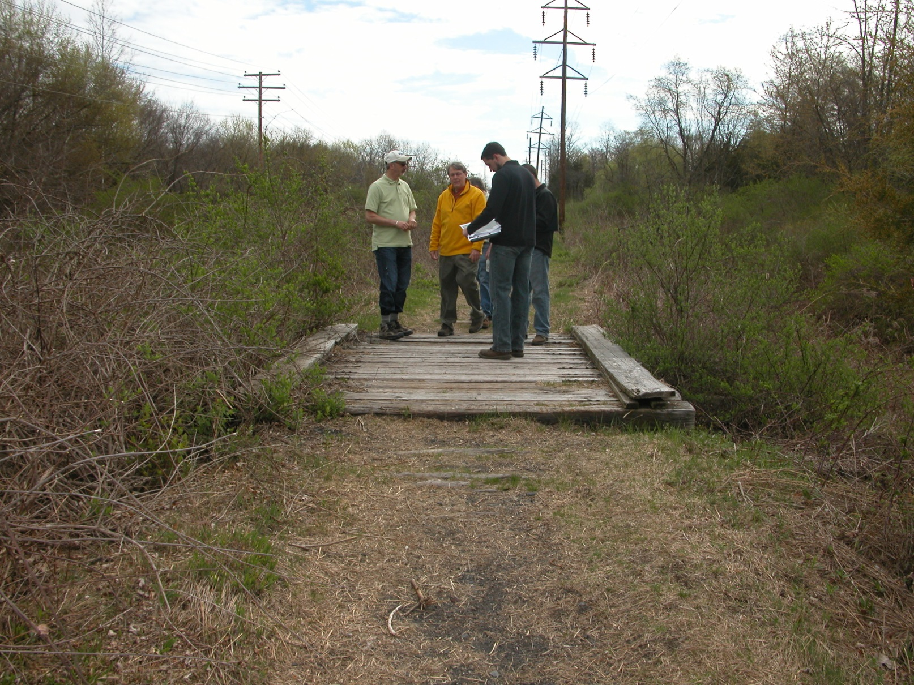
Kingston Rail Trail
O&W-Hurley Rail Trail to City of Kingston

Slide 36
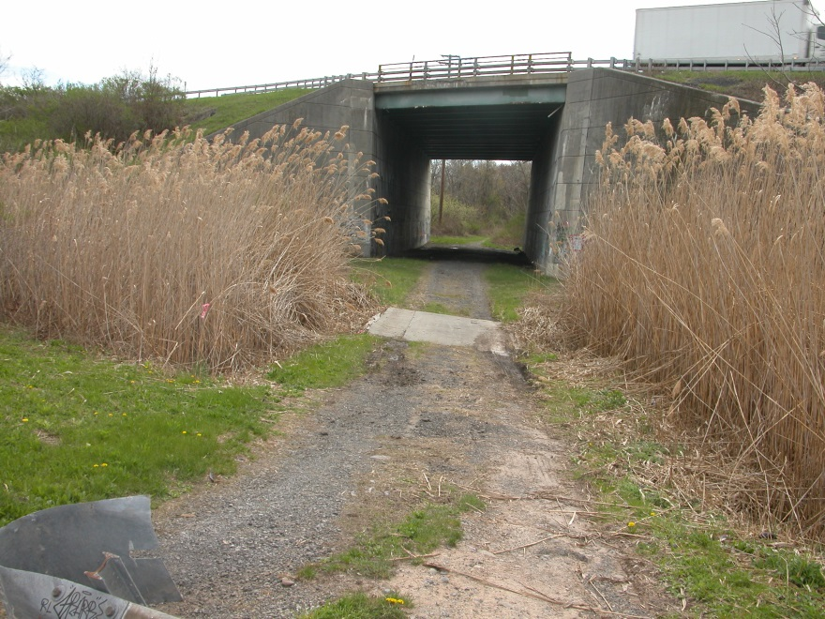
Kingston Rail Trail
O&W-Hurley Rail Trail to City of Kingston

Slide 37
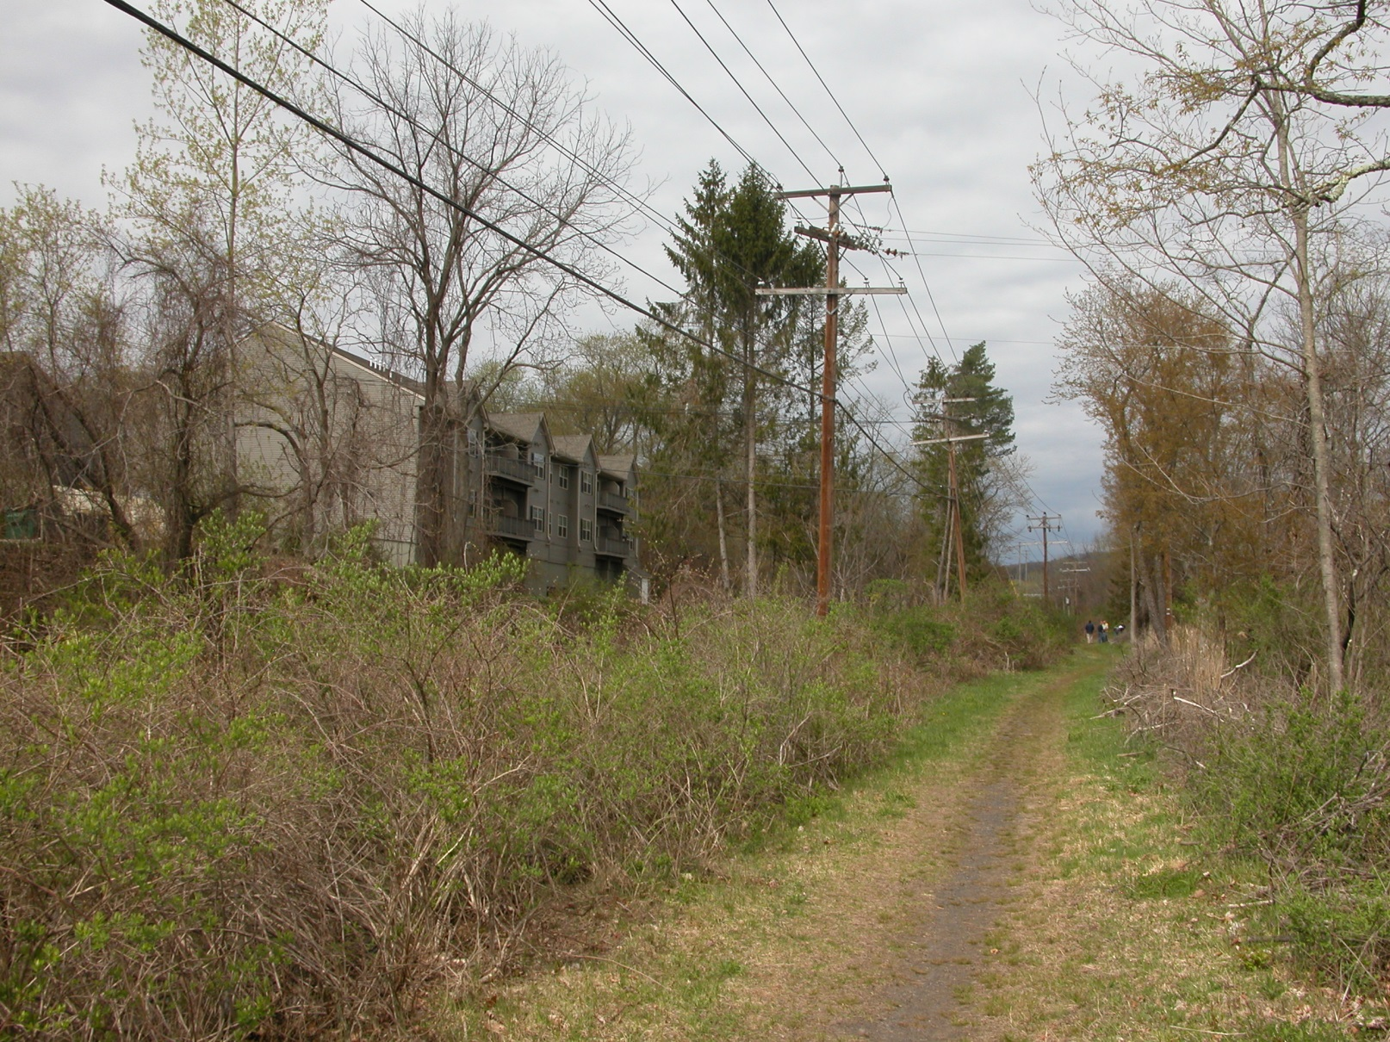
Kingston Rail Trail
O&W-Hurley Rail Trail to City of Kingston

Slide 38
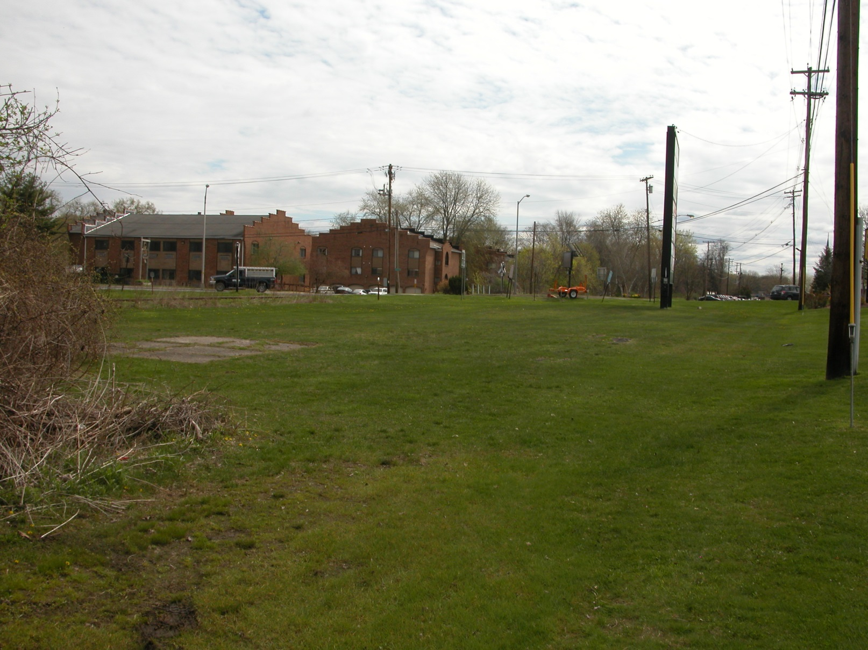
Kingston Rail Trail
O&W-Hurley Rail Trail to City of Kingston

Slide 39
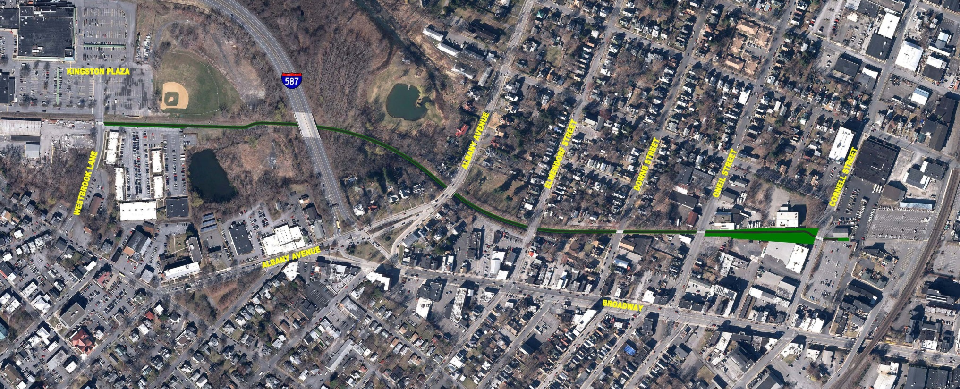
Ulster County Midtown Linear Park
Cornell Street to Westbrook Lane- City of Kingston
Paved Multi-Use Path & Community “Pocket” Park
Connecting Midtown Kingston to Kingston Plaza
Located Along Former U&D Railroad Corridor
0.8 Miles in Length

Slide 40
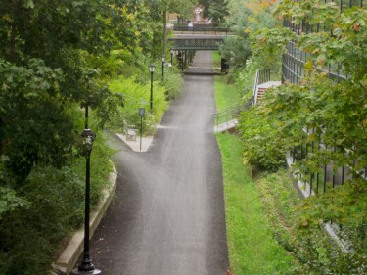
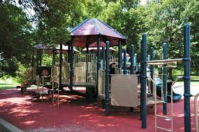
Ulster County Midtown Linear Park
Project Background and Overview
Phased Implementation:
Phase 1- Rail Trail Component
Federal Transportation Funding &
Community Foundations of the
Hudson Valley Grant
Completion in late 2020
**********************************************
Phase 2- Pocket Park Component
Cornell Street Rail Yard
Community Foundations of the
Hudson Valley Grant
Completion in 2021

Slide 41
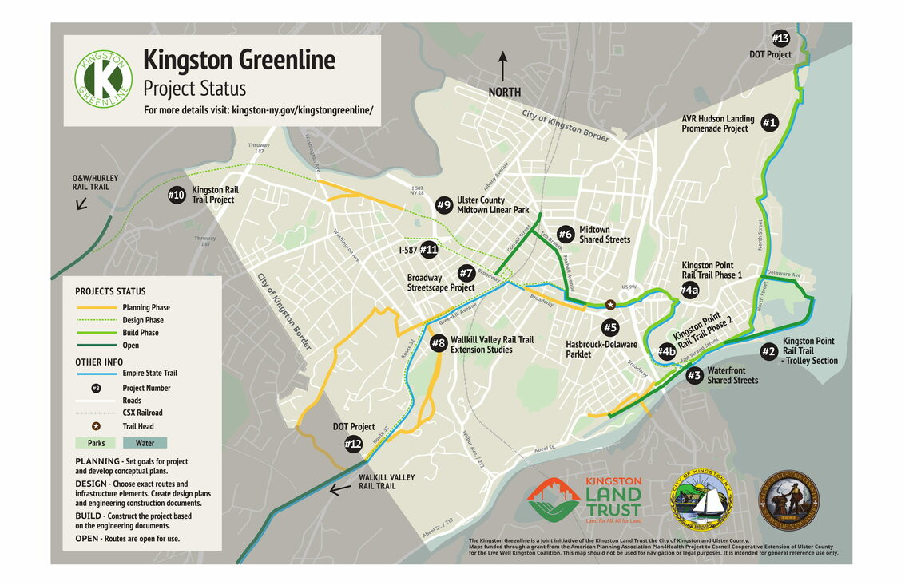
Ulster County Midtown Linear Park
Project Background and Overview
The Midtown Linear Park is part of the Kingston Greenline, a system of trails, linear parks, and complete streets.

Slide 42
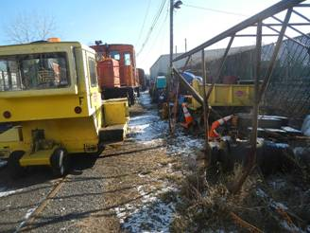
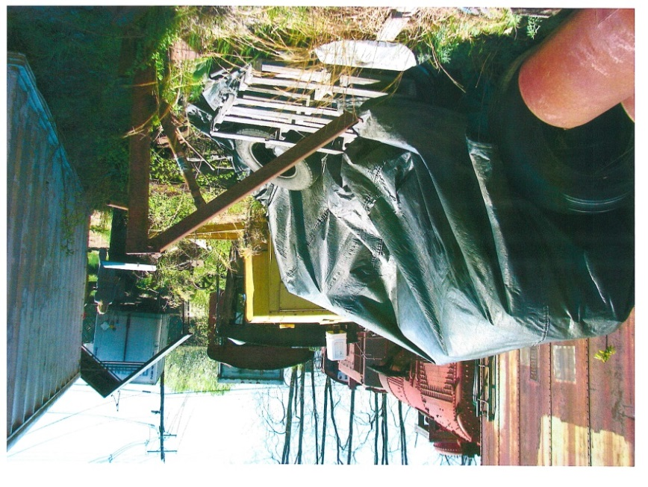
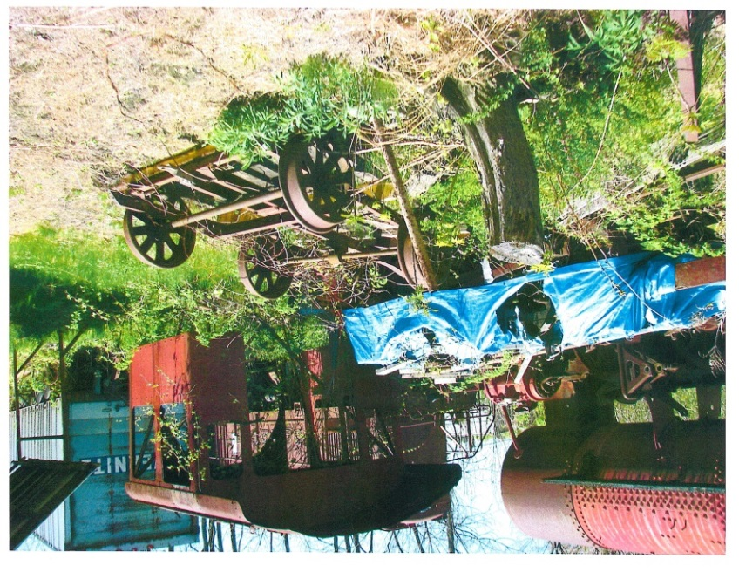
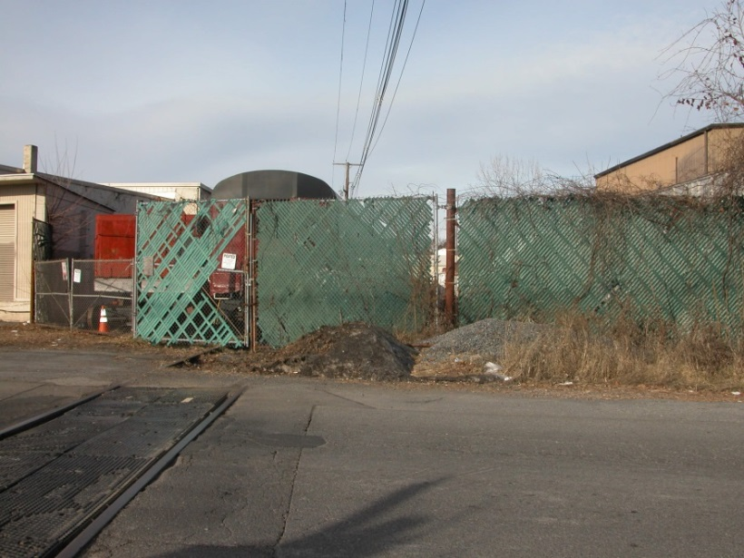
Ulster County Midtown Linear Park
Former Rail Yard Between Cornell and O’Neil Streets

Slide 43
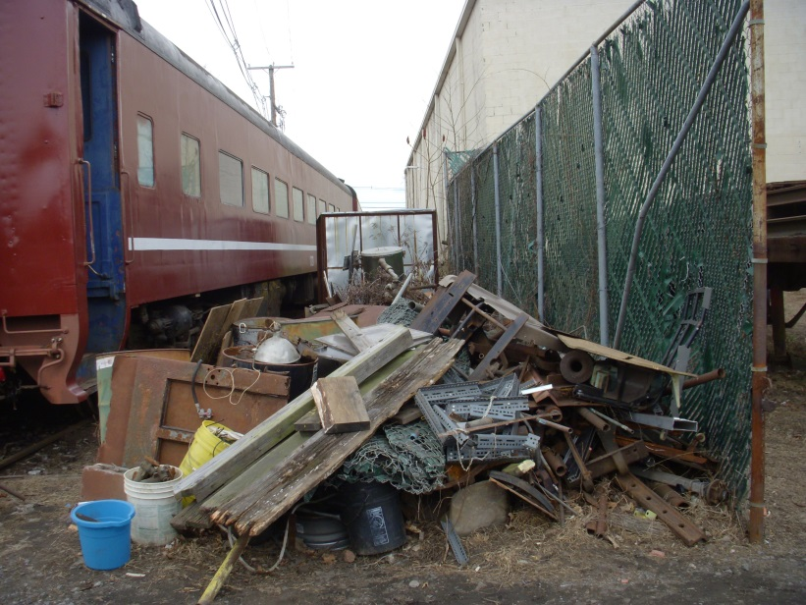
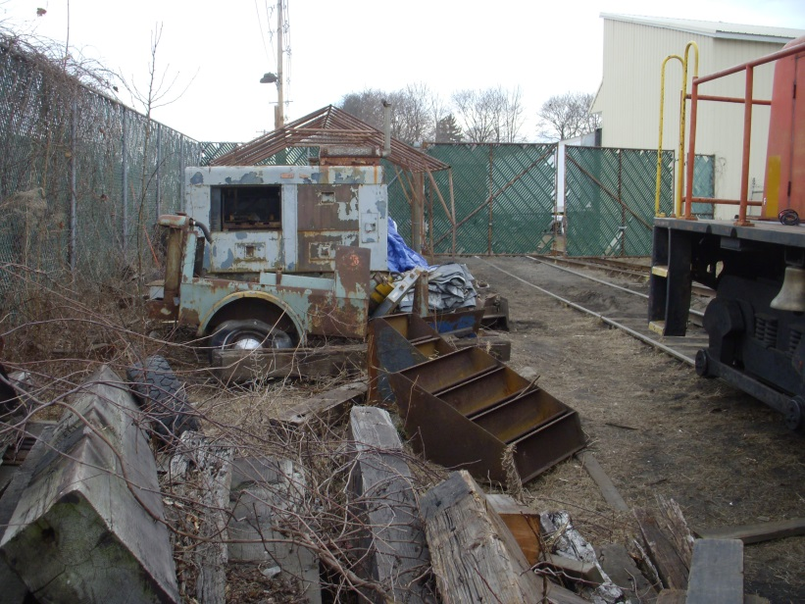
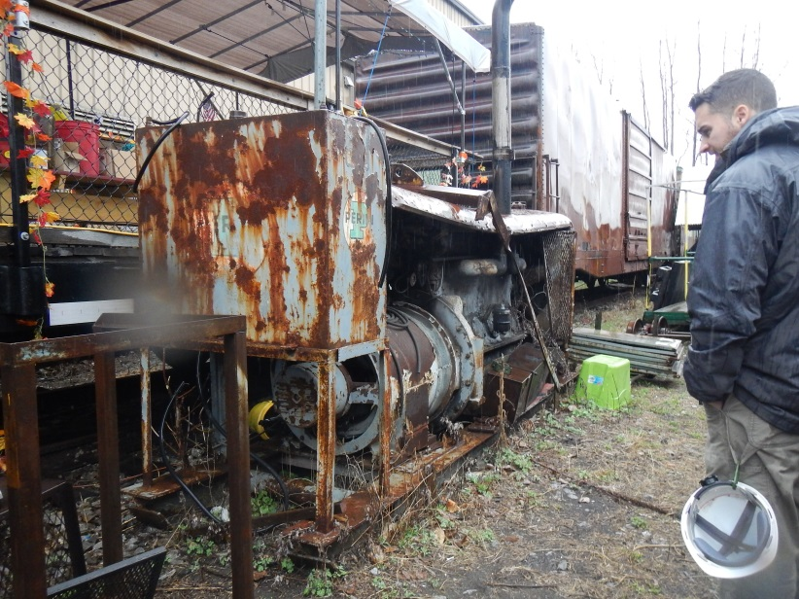
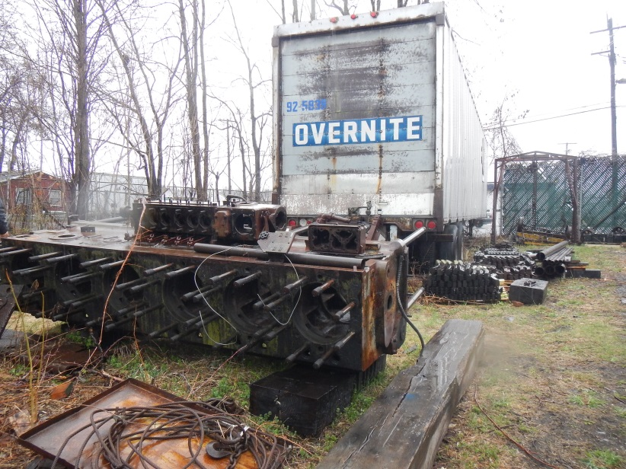
Ulster County Midtown Linear Park
Former Rail Yard Between Cornell and O’Neil Streets

Slide 44
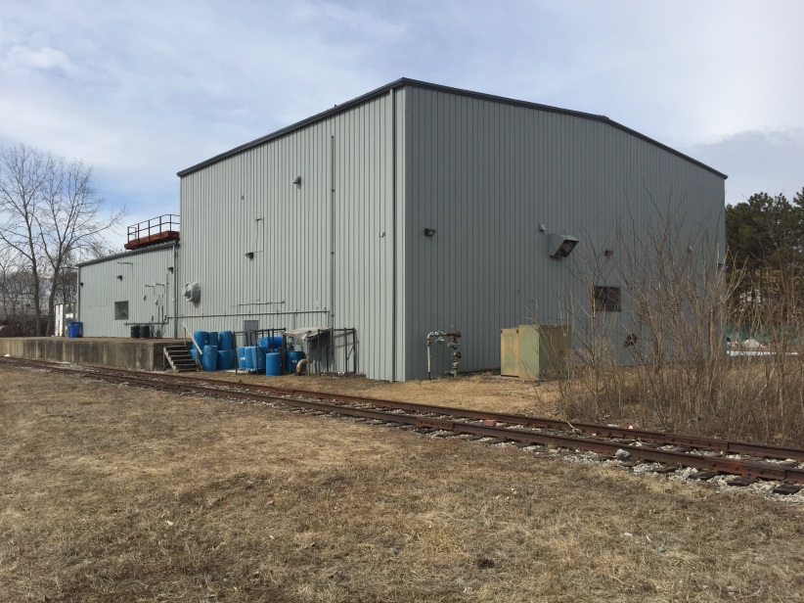



Ulster County Midtown Linear Park
Former Rail Yard After Cleanup

Slide 45




Ulster County Midtown Linear Park
Former Rail Yard- Future Community Park

Slide 46




Ulster County Midtown Linear Park
Former Rail Corridor Photos: Prior to Cleanup

Slide 47




Ulster County Midtown Linear Park
Former Rail Corridor Photos: Prior to Cleanup

Slide 48




Ulster County Midtown Linear Park
Former Rail Corridor Photos: Prior to Cleanup

Slide 49
Ulster County Midtown Linear Park
Former Rail Corridor Photos: Prior to Cleanup

Slide 50




Ulster County Midtown Linear Park
Interim Public Trail: Kingston Plaza to Downs Street

Slide 51




Ulster County Midtown Linear Park
Interim Public Trail: Kingston Plaza to Downs Street

Slide 52

Ulster County Midtown Linear Park
Interim Public Trail: Kingston Plaza to Downs Street

Slide 53

Ulster County Midtown Linear Park
Interim Public Trail: Kingston Plaza to Downs Street

Slide 54


Ulster County Trail Network
Overview and Update
Thank You
For More Information:
Ulster County Planning Department
https://ulstercountyny.gov/planning/rails-and-trails
https://www.facebook.com/ulsterplanning/

